Slide 1
Lecture 13 A simple Smart Contract

Slide 2
What is a State Machine?
A state machine is any device storing the status of something at a given time.
State machines are represented using state diagrams.
Sounds familiar?

Slide 3
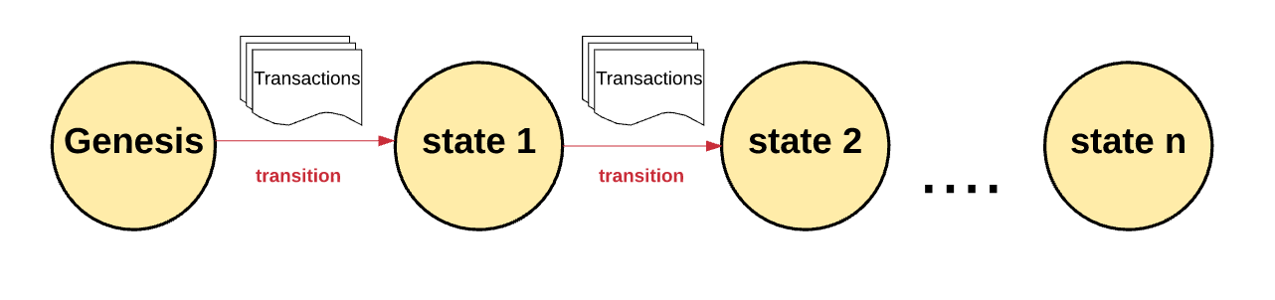
What is Blockchain?
A transactional decentralized singleton state machine
Notes:
https://medium.com/@preethikasireddy/how-does-ethereum-work-anyway-22d1df506369

Slide 4
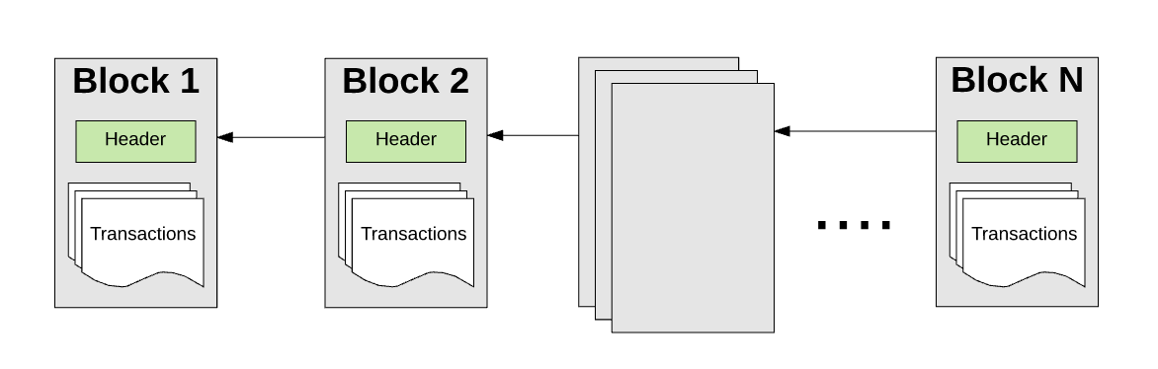
What is Blockchain?
A transactional decentralized singleton state machine
Notes:
https://medium.com/@preethikasireddy/how-does-ethereum-work-anyway-22d1df506369

Slide 5
What about bitcoin’s blockchain?
The Bitcoin’s blockchain, tracks the state of units of bitcoin and their ownership.
You can think of Bitcoin as a distributed state machine, where transactions cause a global state transition, altering the ownership of coins.

Slide 6
How this can be generalized?
What if we can replace bitcoins with a general purpose data store?
It will open up numerous new use-cases and domains for blockchain

Slide 7
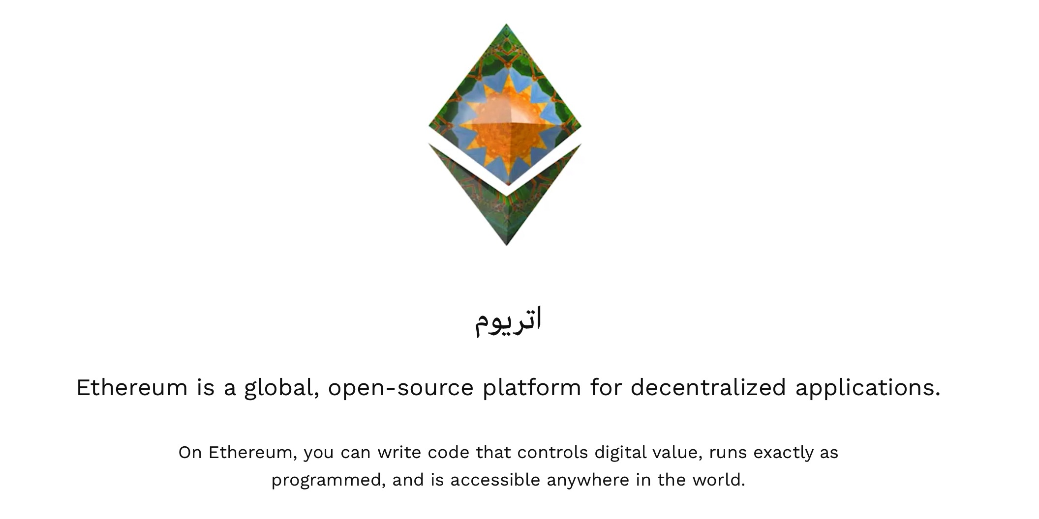

Slide 8
Ethereum: A General-Purpose Blockchain
Ethereum is also a distributed state machine.
Instead of tracking only the state of currency ownership, Ethereum tracks the state transitions of a general-purpose data store,
a store that can hold any data expressible as a key–value tuple.
A key–value data store holds arbitrary values, each referenced by some key; for example, the value “Mastering Ethereum” referenced by the key “Book Title”.

Slide 9
Compared to Bitcoin
A turing complete language for writing smart contracts
An execution environment (EVM) for executing the contracts.

Slide 10
Hands-on Introduction to Ethereum

Slide 11
Ether Currency Units
Ethereum’s currency unit is called ether, identified also as “ETH”
Ether is subdivided into smaller units, down to the smallest unit possible, which is named wei.
The value of ether is always represented internally in Ethereum as an unsigned integer value denominated in wei.
When you transact 1 ether, the transaction encodes 1000000000000000000 wei as the value.

Slide 12
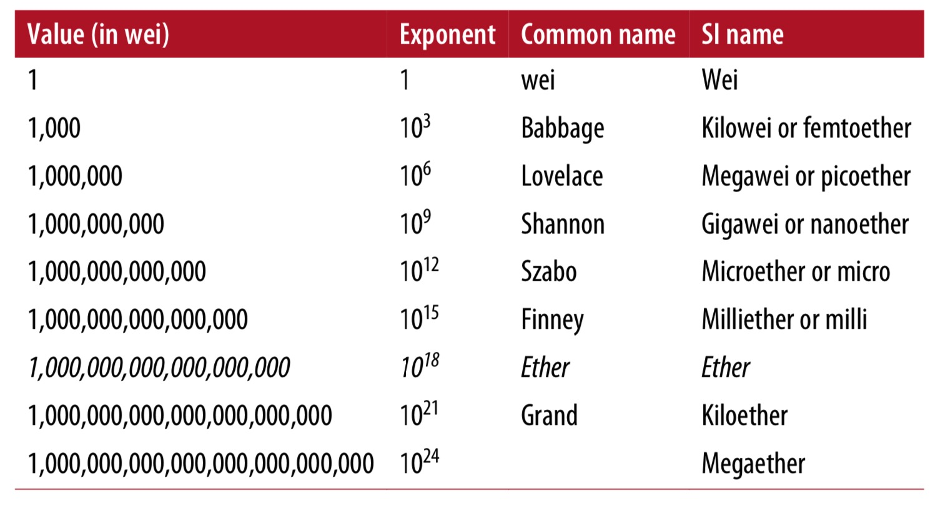
Ether Currency Units
Notes:
Ethereum (ETH) uses several different units to represent the cryptocurrency and to measure transaction fees within its network. Here are some of the common Ethereum currency units and their abbreviations:
1. **Ether (ETH):** The base currency unit of the Ethereum network. Ether is used for various purposes, including sending value, participating in ICOs (Initial Coin Offerings), and interacting with smart contracts.
2. **Wei:** Wei is the smallest unit of Ether, named after Wei Dai, a cryptography and cryptocurrency pioneer. One Ether is equivalent to 1,000,000,000,000,000,000 Wei.
3. **Gwei (or Gigawei):** Gwei is a more commonly used unit for measuring gas prices and transaction fees on the Ethereum network. One Gwei is equivalent to 1,000,000,000 Wei. Prices for gas are often denominated in Gwei.
4. **Szabo:** Named after Nick Szabo, a cryptocurrency and smart contract pioneer. One Szabo is equivalent to 1,000,000,000 Gwei.
5. **Finney:** Named after Hal Finney, a cryptographic activist and the first recipient of a Bitcoin transaction. One Finney is equivalent to 1,000,000,000 Szabo.
6. **Kwei (or Ada):** Kwei is equivalent to 1,000 Wei, and it's not as commonly used as Gwei for gas prices.
7. **Mwei (or Babbage):** Mwei is equivalent to 1,000,000 Wei.
These units are used for different purposes, but Gwei is the most commonly used unit when discussing transaction fees and gas costs within the Ethereum network. When sending Ether or interacting with smart contracts, most people refer to the value in Ether (ETH) or Gwei. It's important to be familiar with these units, especially if you are actively involved in Ethereum transactions and smart contract development.

Slide 13
Ethereum Wallet
A software application that helps you manage your Ethereum account.
It can be a mobile wallet or a desktop wallet or a web-based wallet.

Slide 14
MetaMask
MetaMask is a browser extension wallet that runs in your browser (Chrome, Firefox, Opera, or Brave Browser).
It is easy to use and convenient for testing, as it is able to connect to a variety of Ethereum nodes and test blockchains. MetaMask is a web-based wallet.

Slide 15
Getting Started with MetaMask
Open the Google Chrome browser and navigate to https://chrome.google.com/ webstore/category/extensions.

Slide 16
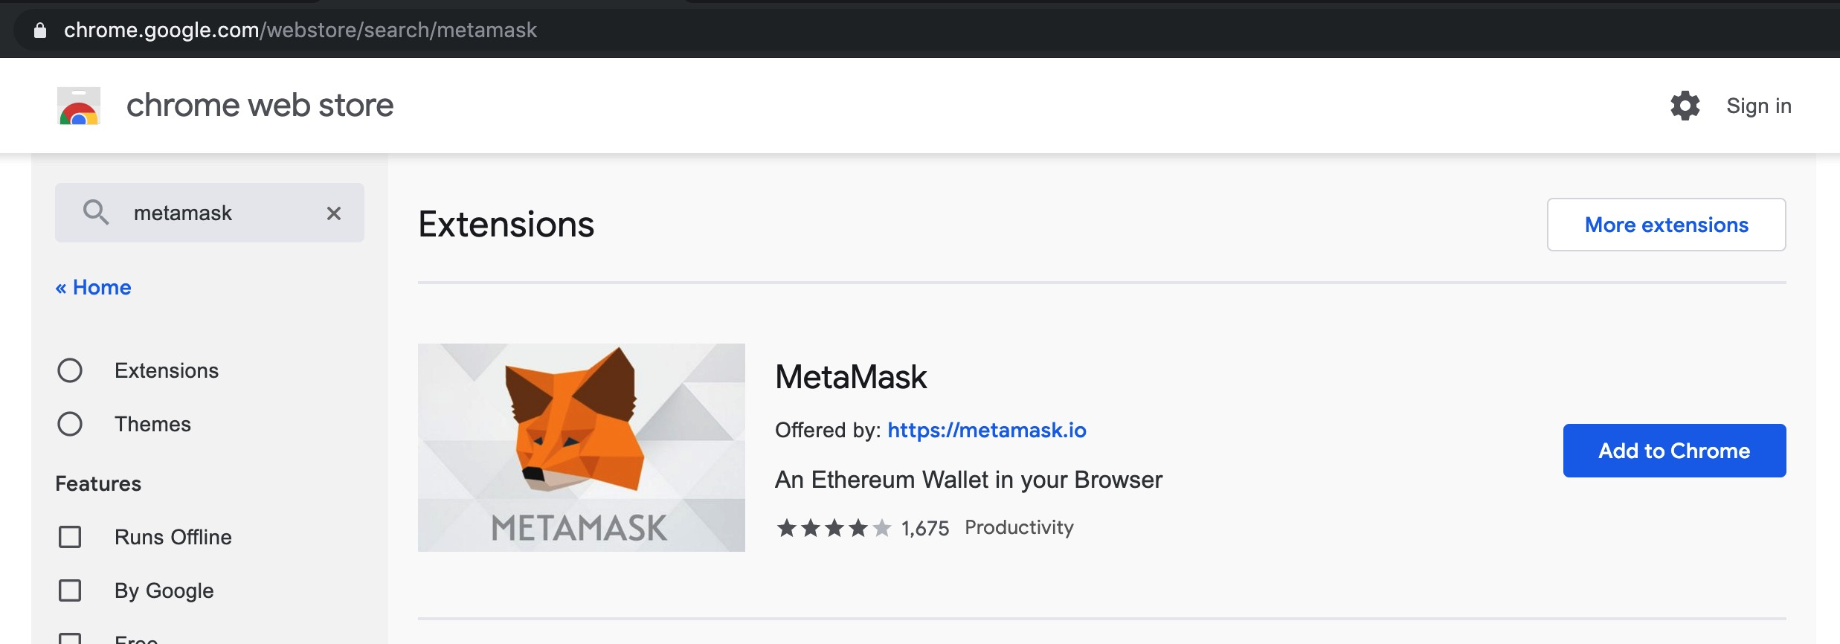

Slide 17
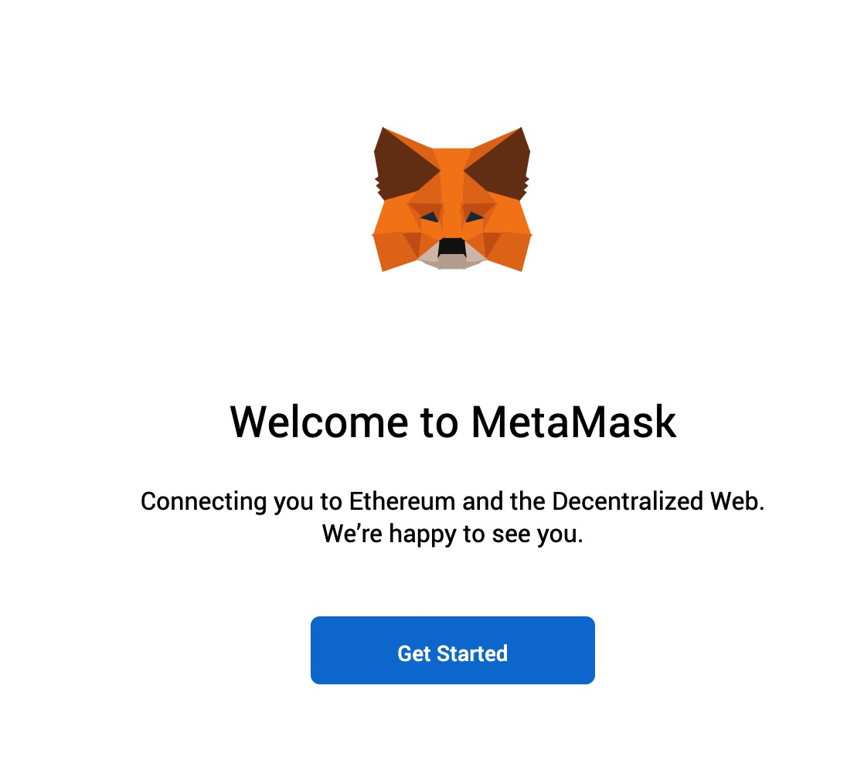

Slide 18
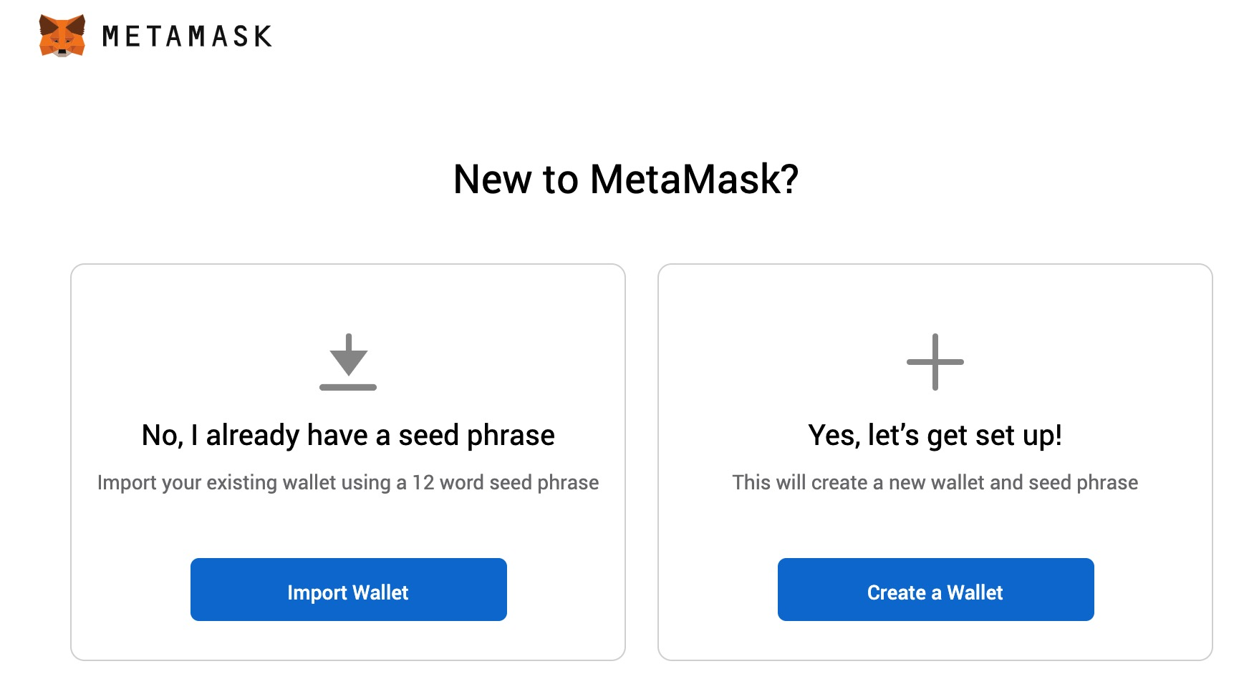

Slide 19
Here is mine ...
thank uncle matrix unusual crucial spice claim clarify ranch exercise exhaust secret

Slide 20
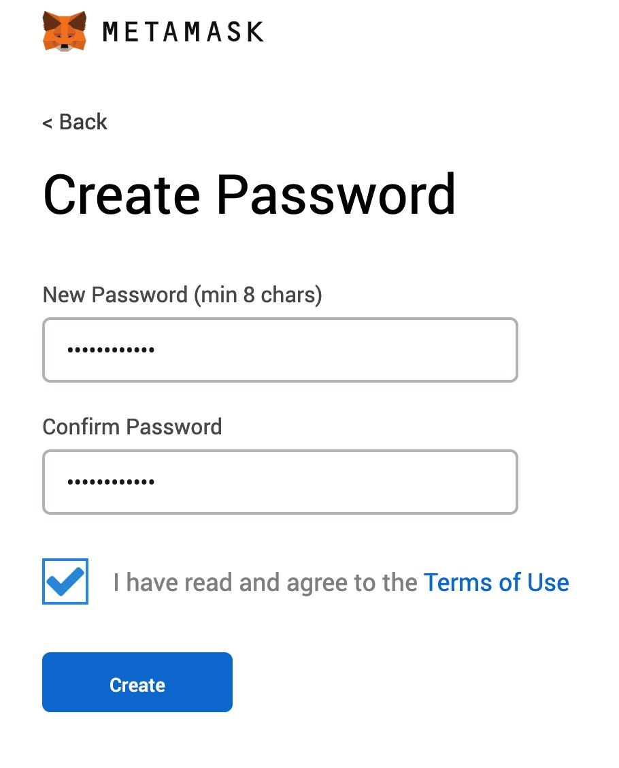

Slide 21
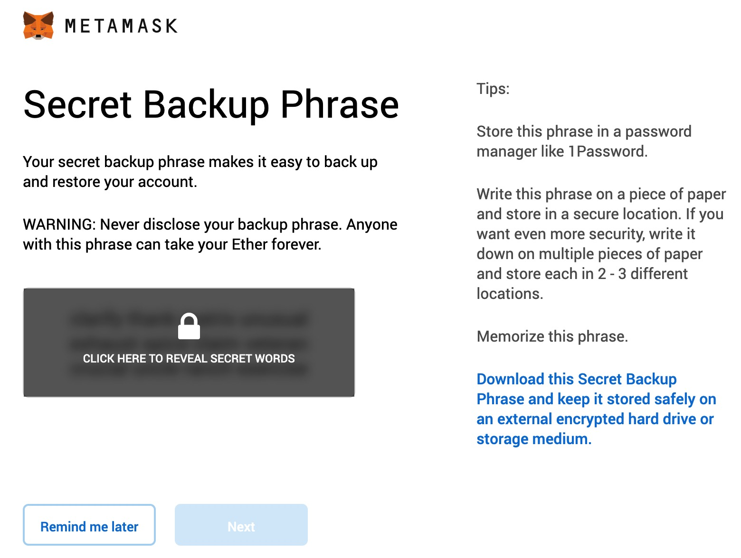

Slide 22
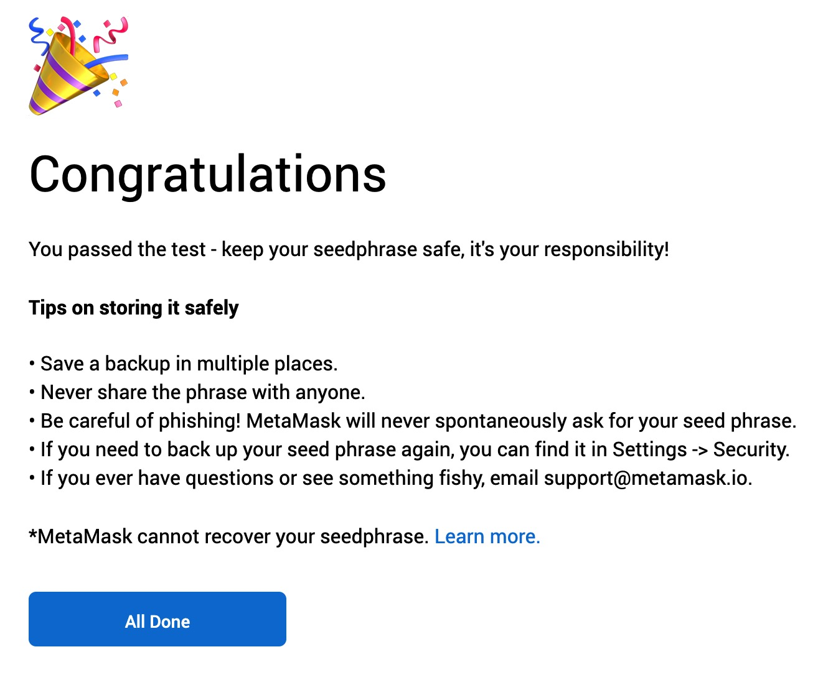

Slide 23
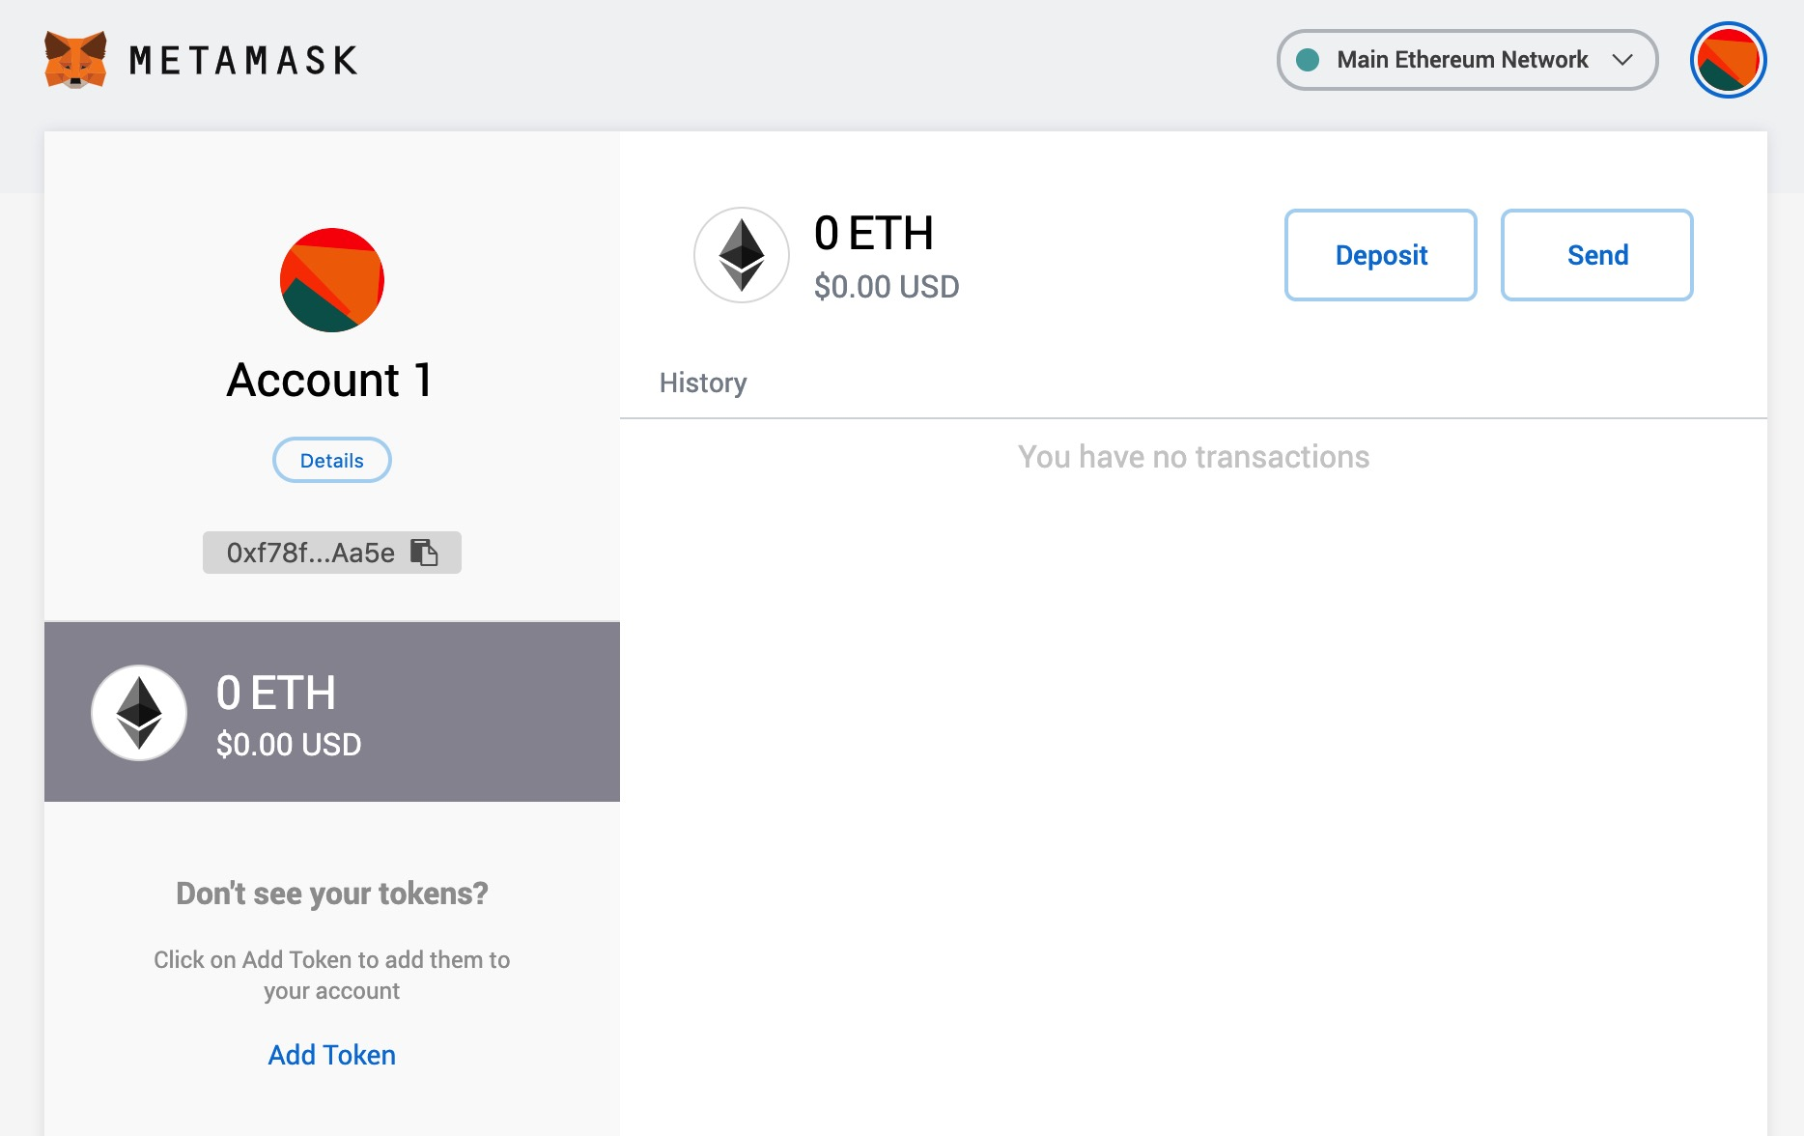

Slide 24
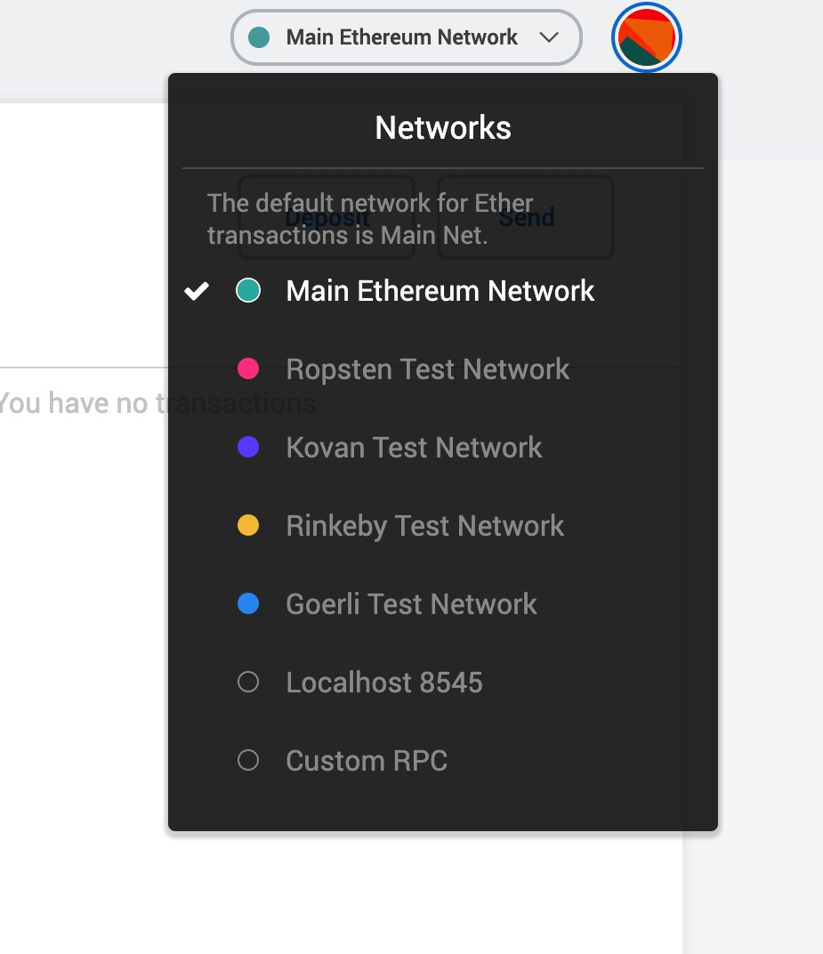
Switching Networks
you can choose between multiple Ethereum networks. By default, MetaMask will try to connect to the main network.
Notes:
Ethereum, the second-largest blockchain platform after Bitcoin, has several different networks or blockchains, each serving different purposes and use cases. These networks vary in terms of security, scalability, and features. Here are some of the most notable Ethereum networks:
1. **Ethereum Mainnet:** The Ethereum mainnet, or main network, is the primary and most widely used Ethereum blockchain. It is where Ether (ETH), the native cryptocurrency, is used for transactions and is home to a vast number of decentralized applications (DApps), smart contracts, and various tokens. It's the most secure and widely adopted Ethereum network.
2. **Ropsten:** Ropsten is one of the Ethereum testnets, which are used for testing purposes. Ropsten uses Proof of Work (PoW) for consensus, just like the Ethereum mainnet. It allows developers to test smart contracts and DApps without using real Ether.
3. **Rinkeby:** Rinkeby is another Ethereum testnet, but it uses Proof of Authority (PoA) for consensus. It's more stable and suitable for testing DApps that require a more consistent environment.
4. **Goerli:** Goerli is a cross-client Ethereum testnet that uses a mix of Proof of Work (PoW) and Proof of Authority (PoA) consensus mechanisms. It was created to facilitate compatibility testing among various Ethereum clients.
5. **Kovan:** Kovan is a PoA-based Ethereum testnet known for its simplicity and ease of use. It's widely used by developers for testing purposes.
6. **Optimistic Ethereum:** Optimistic Ethereum is a layer 2 scaling solution built on top of the Ethereum mainnet. It aims to improve scalability and reduce transaction fees by using optimistic rollups. It's not a separate network but a technology layer for enhancing the mainnet's performance.
7. **Arbitrum:** Similar to Optimistic Ethereum, Arbitrum is a layer 2 scaling solution for Ethereum, designed to increase throughput and reduce transaction costs.
8. **xDai Chain:** xDai is a stablecoin sidechain of Ethereum that focuses on fast and cost-effective transactions. It uses a stablecoin called xDai as its native currency.
9. **Binance Smart Chain (BSC):** Binance Smart Chain is a separate blockchain that is compatible with Ethereum, allowing developers to use Ethereum tools and migrate DApps to BSC while benefiting from faster and cheaper transactions.
10. **Polygon (formerly Matic):** Polygon is a framework for building Ethereum-compatible blockchains, often referred to as "sidechains." It provides various solutions for scaling and improving the performance of Ethereum-based DApps.
Each of these Ethereum networks serves different purposes, from the primary Ethereum mainnet for production use to various testnets for development and testing, as well as scaling solutions and sidechains for improved scalability and cost-effectiveness. Developers and users can choose the appropriate Ethereum network based on their specific requirements and use cases.

Slide 25
Switching Networks
Main Ethereum Network
The main public Ethereum blockchain. Real ETH, real value, and real consequences.
Ropsten Test Network
Ethereum public test blockchain and network. ETH on this network has no value.
…
Localhost 8545
Connects to a node running on the same computer as the browser. The node can be part of any public blockchain (main or testnet), or a private testnet.

Slide 26
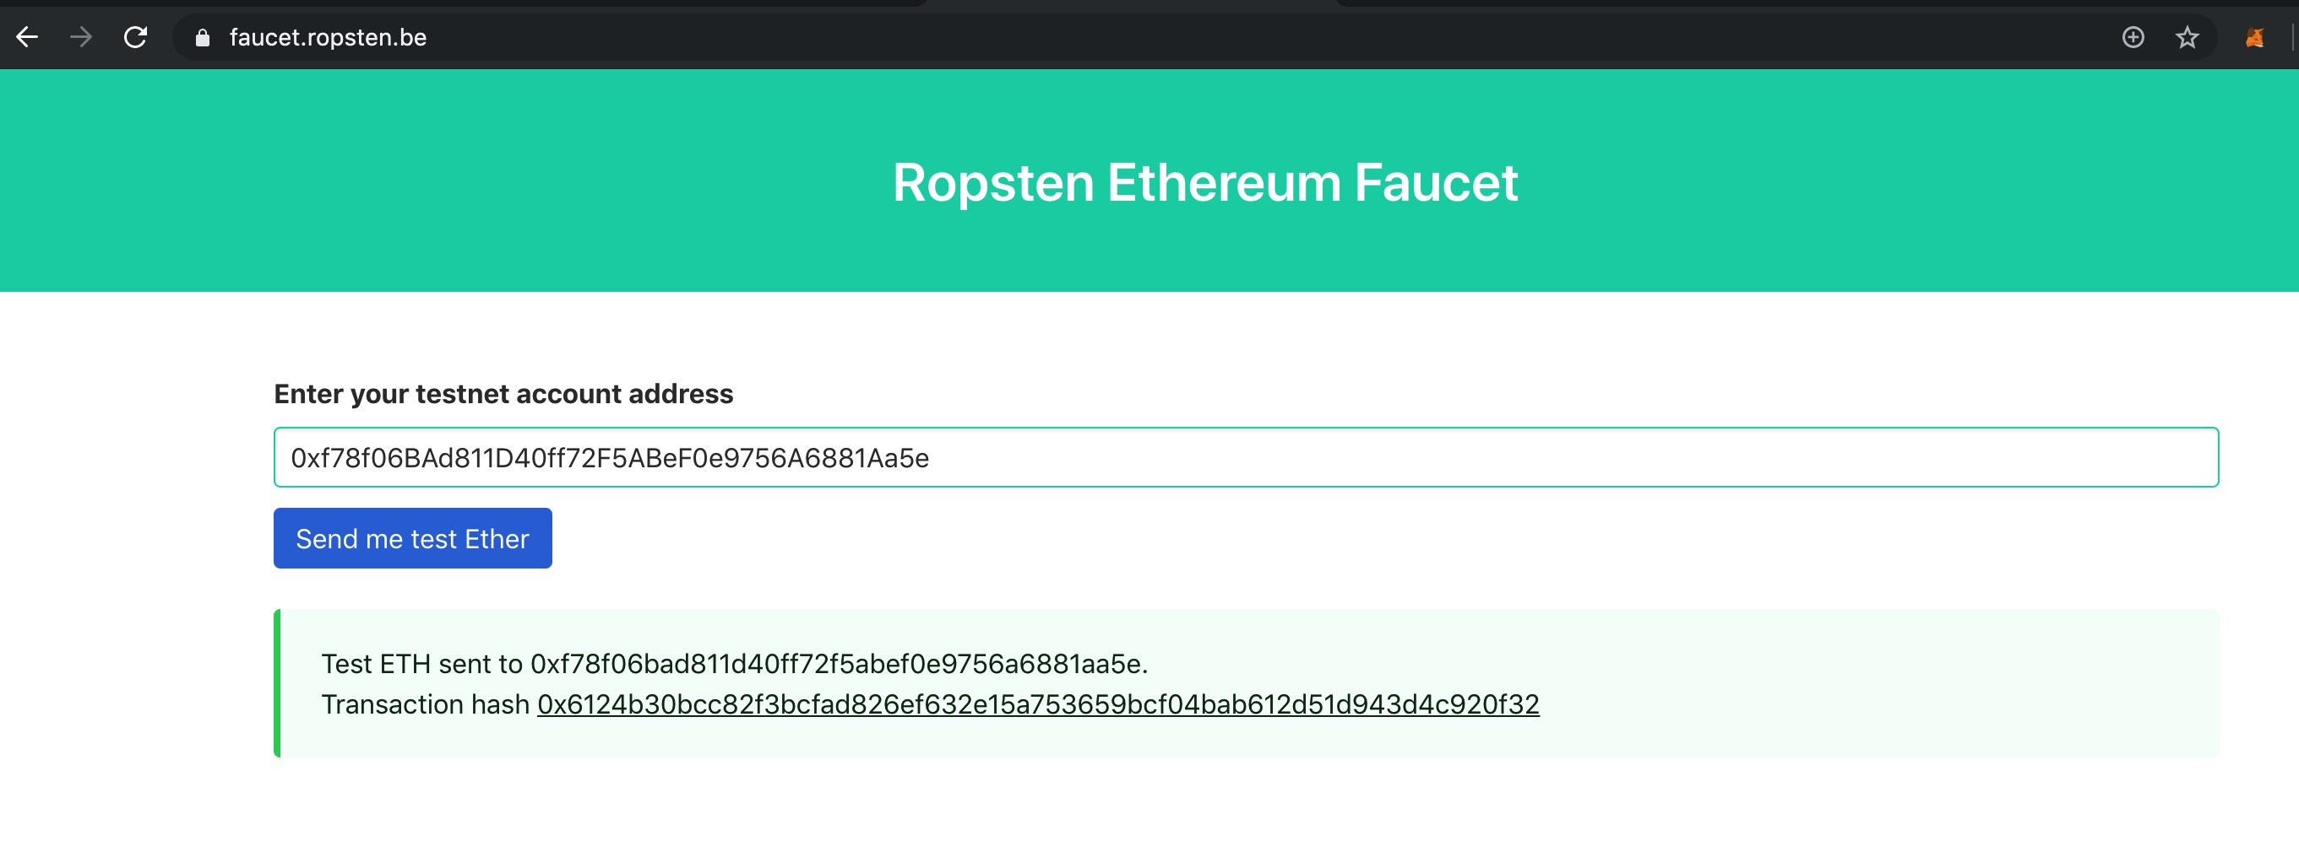
Getting Some Test Ether

Slide 27
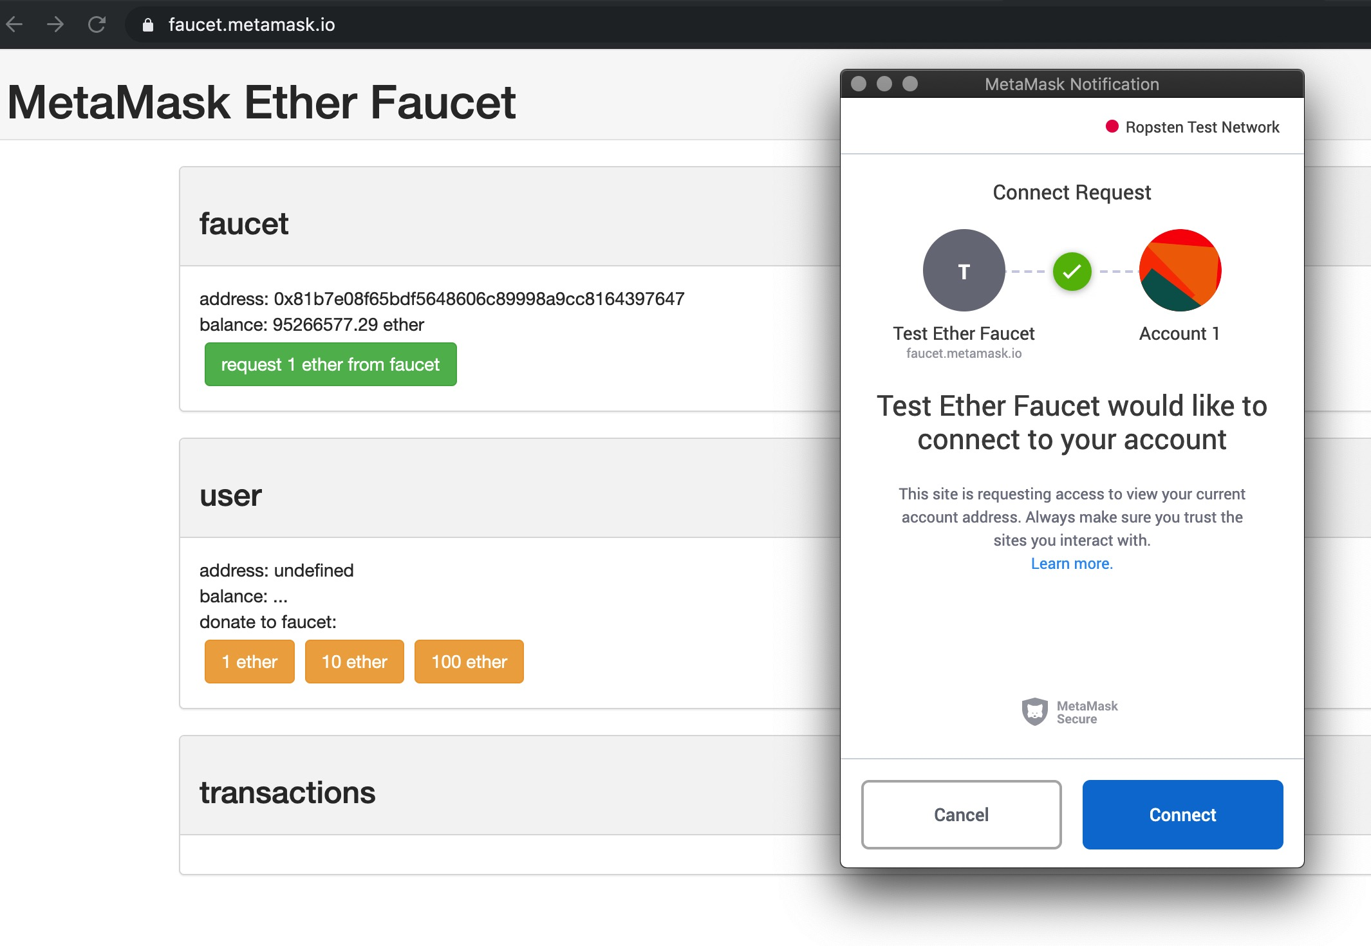
Getting Some Test Ether

Slide 28
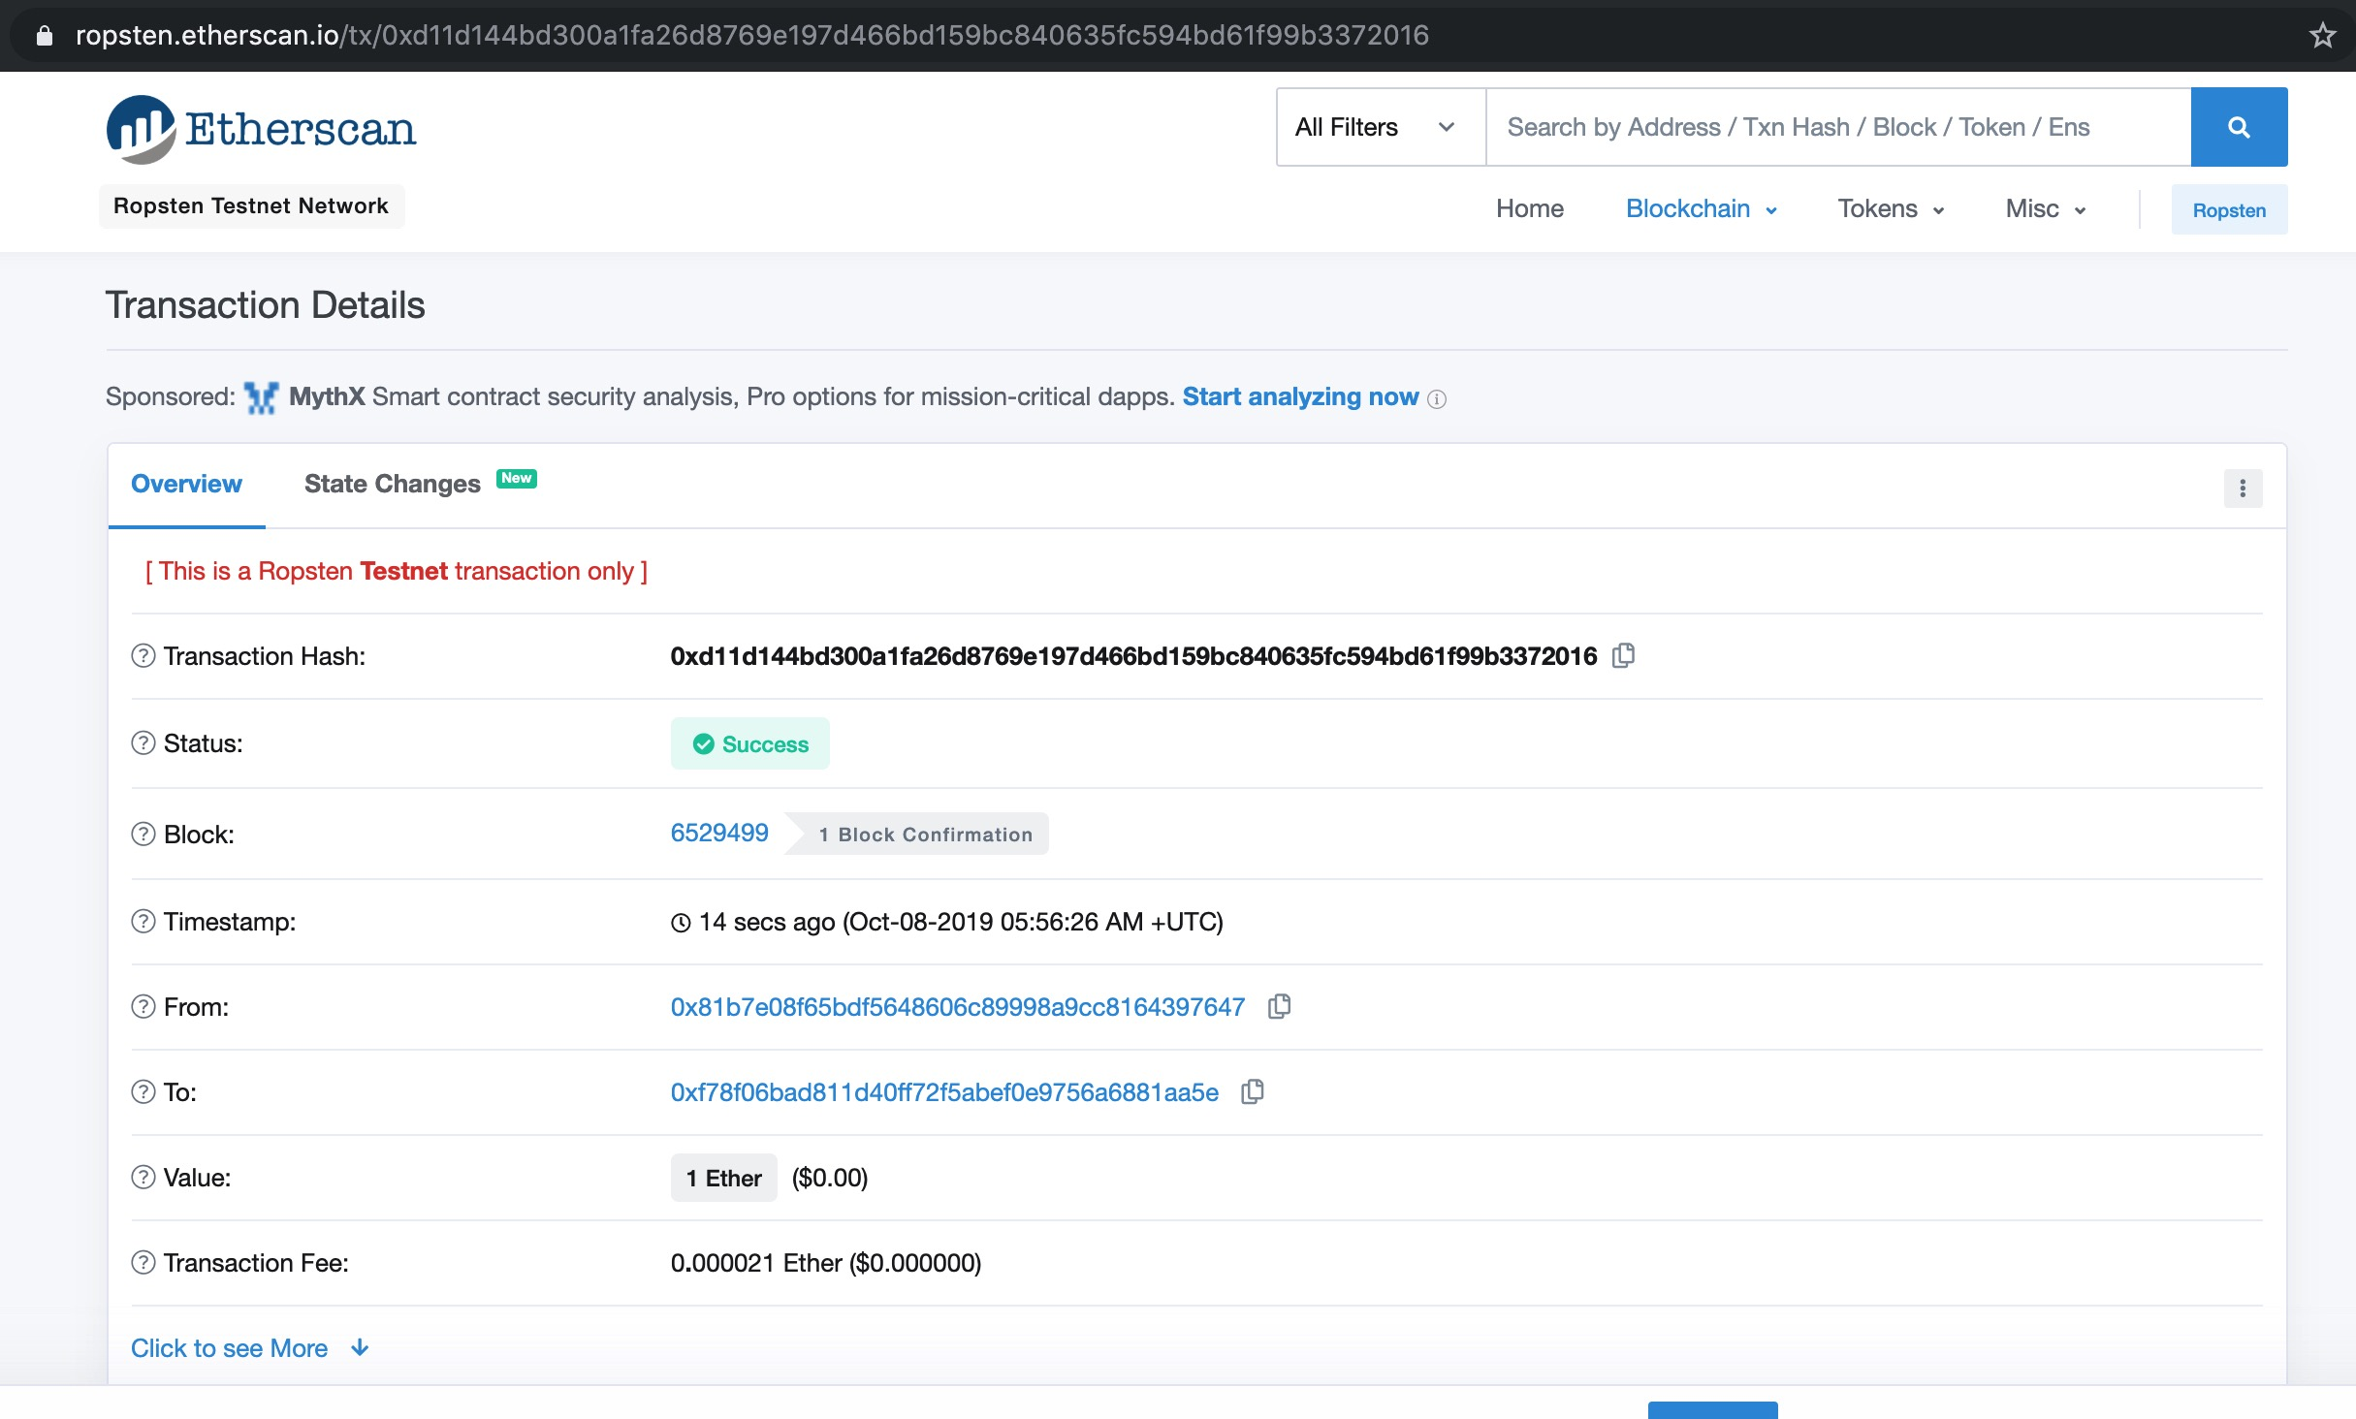
Getting Some Test Ether

Slide 29
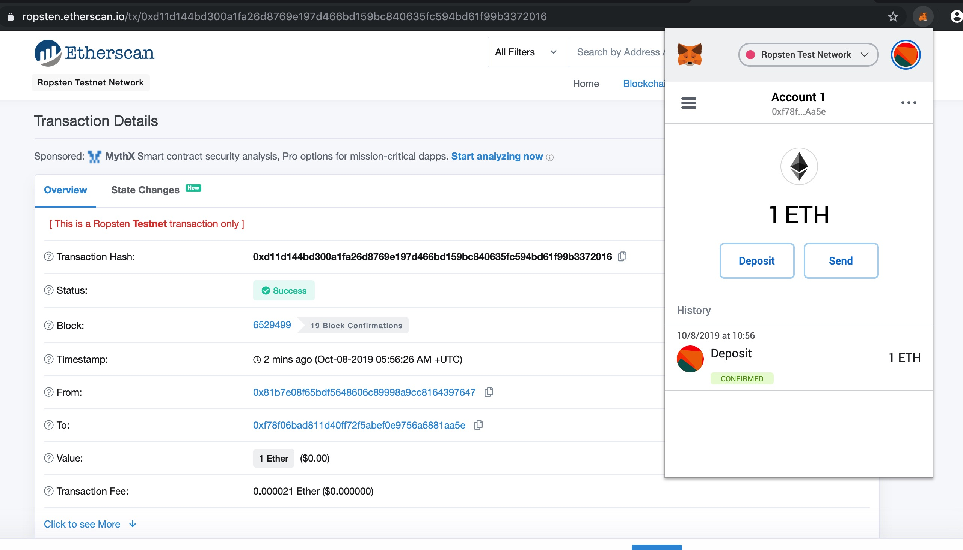
Getting Some Test Ether

Slide 30
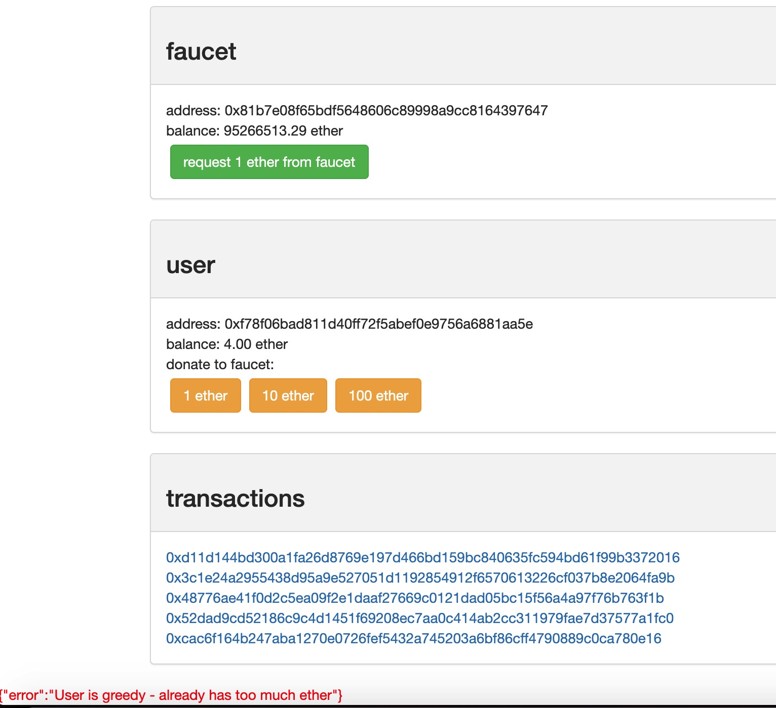
Some more Ethers ...

Slide 31
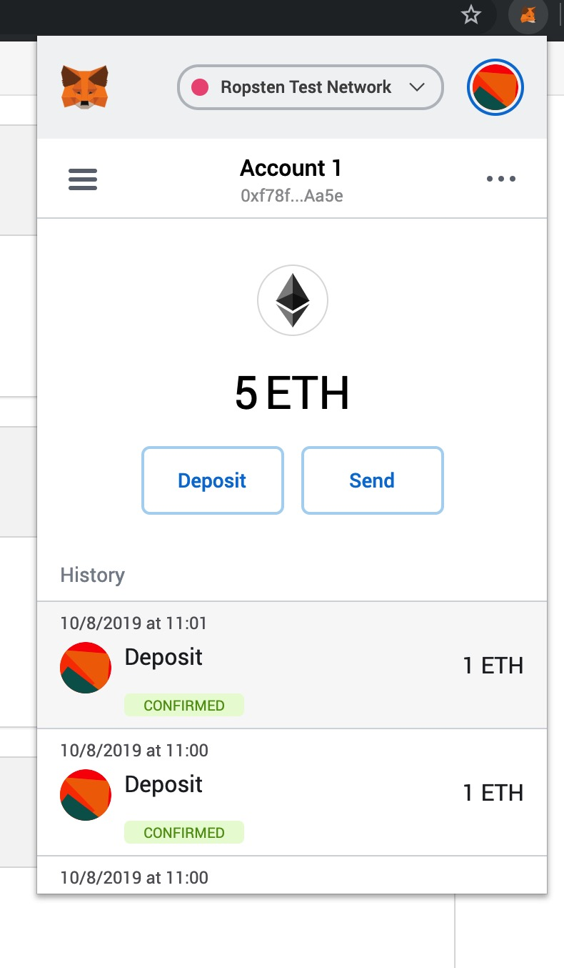
Some more Ethers ...

Slide 32
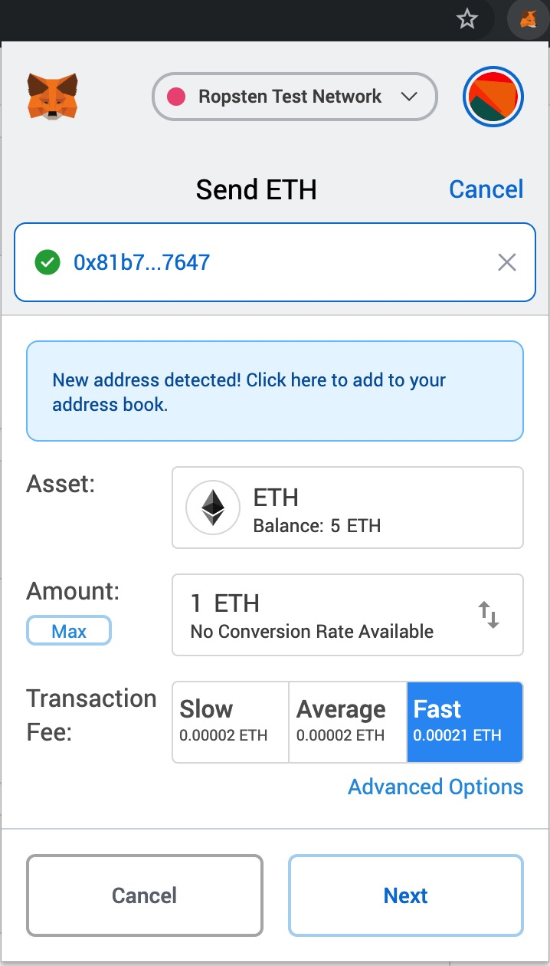
Time for donations ...

Slide 33
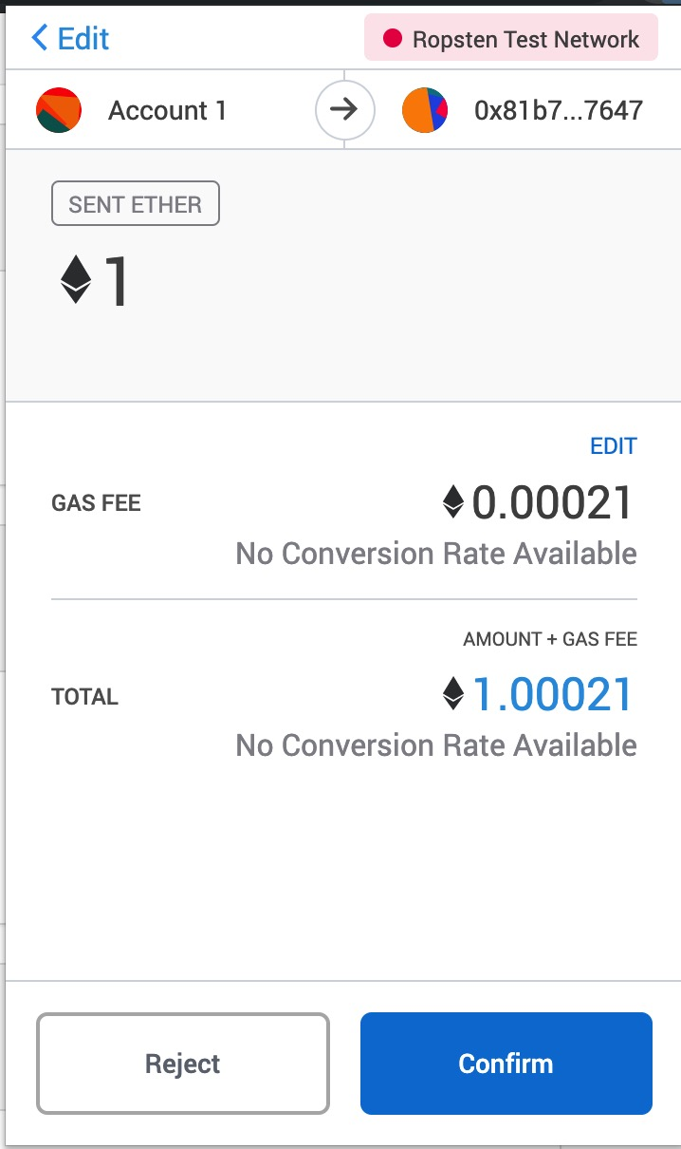
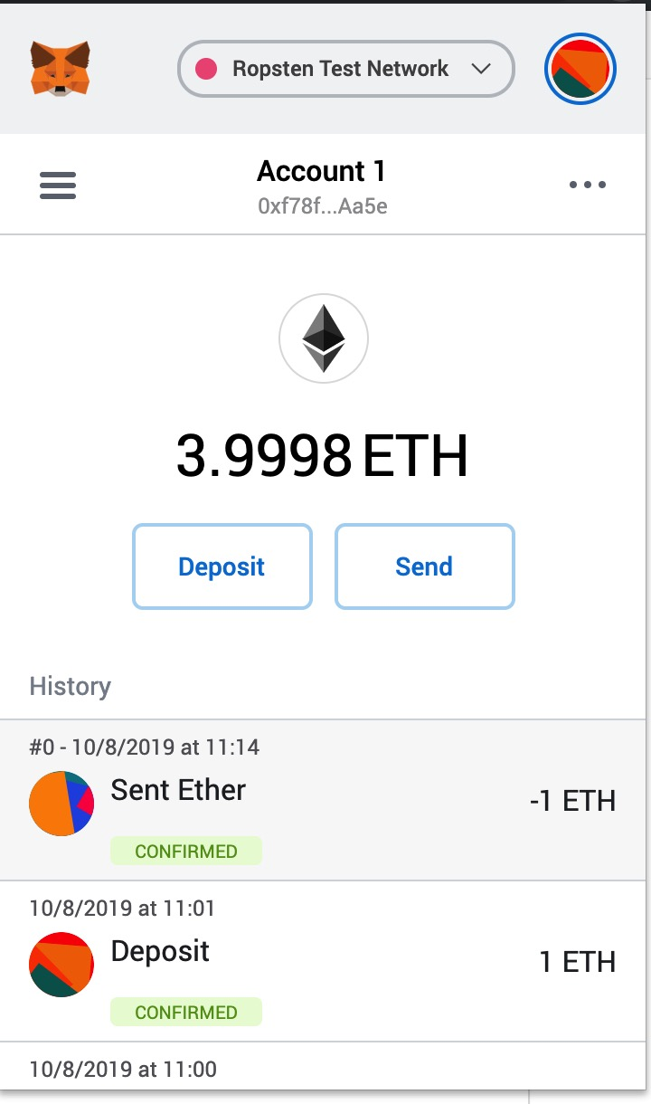
Time for donations ...

Slide 34
Transaction History of an Address
You can view all these transactions using the ropsten.etherscan.io block explorer.

Slide 35
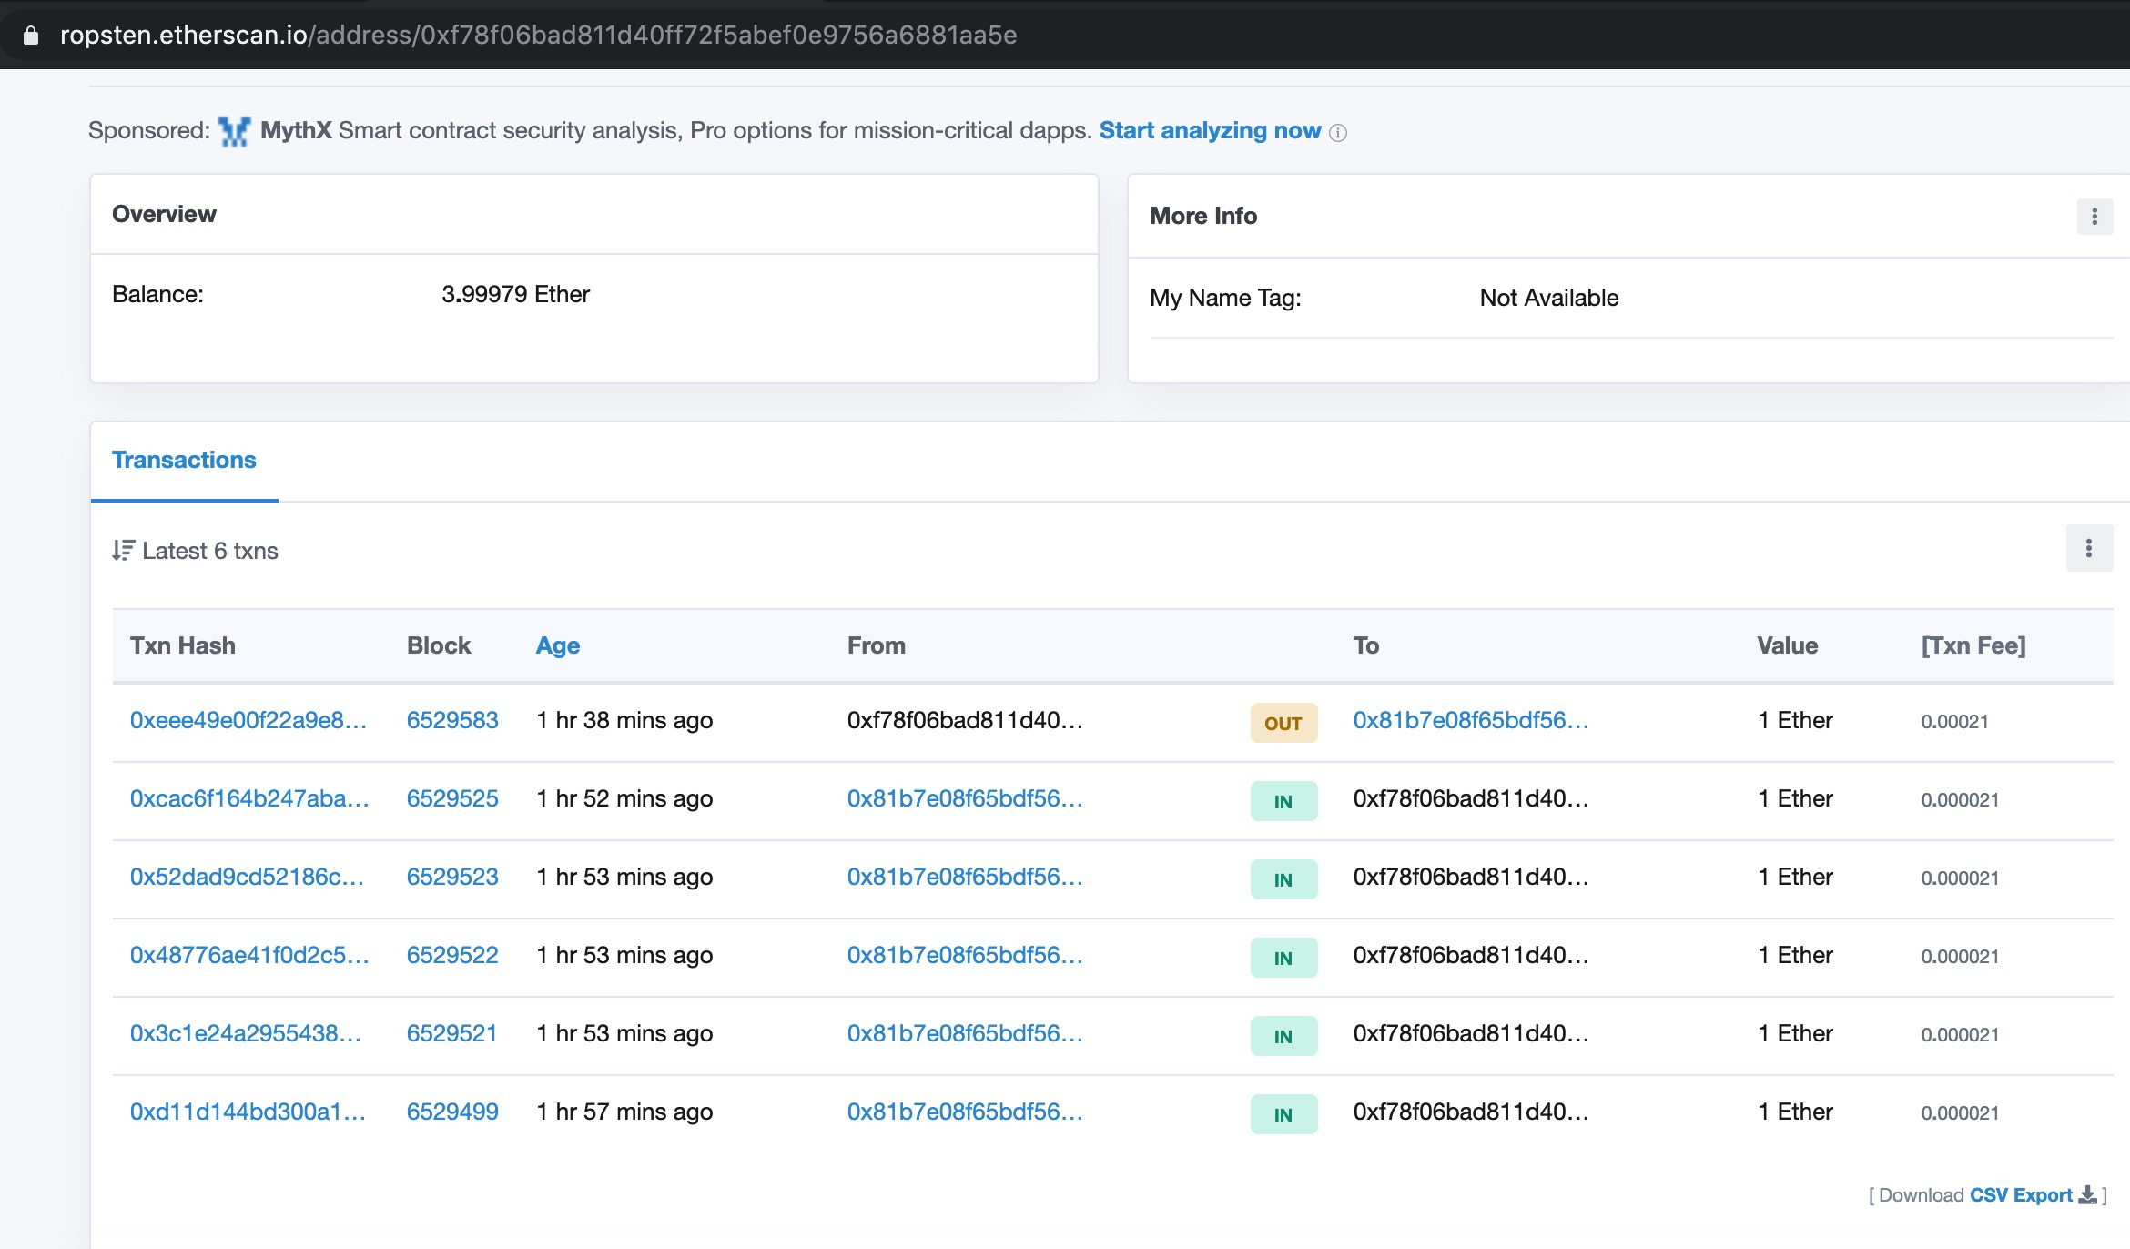
Transaction History of an Address

Slide 36
Introducing the World Computer
So far, we’ve treated Ethereum as a cryptocurrency. But Ethereum is much, much more.
Cryptocurrency function is subservient to Ethereum’s function as a decentralized world computer.

Slide 37
Introducing the World Computer
Ether is meant to be used to pay for running smart contracts, which run on an emulated computer called the Ethereum Virtual Machine (EVM).
Each node on the Ethereum network runs a local copy of the EVM to validate contract execution.

Slide 38
Accounts in Ethereum
There are two types of accounts in Ethereum.
Externally Owned Accounts (EOAs)
Contract Accounts

Slide 39
EOAs and Contracts
EOAs have a private key; having the private key means control over access to funds or contracts.
A contract account has smart contract code, which a simple EOA can’t have.
A contract account does not have a private key.
It is owned (and controlled) by the logic of its smart contract code

Slide 40
Contracts
Contracts have addresses, just like EOAs. Contracts can also send and receive ether, just like EOAs.
When a transaction destination is a contract address, it causes that contract to run in the EVM, using the transaction, and the transaction’s data, as its input.
In this way, transactions can call functions within contracts.

Slide 41
Contracts
Only EOAs can initiate transactions, but contracts can react to transactions by calling other contracts, building complex execution paths.

Slide 42
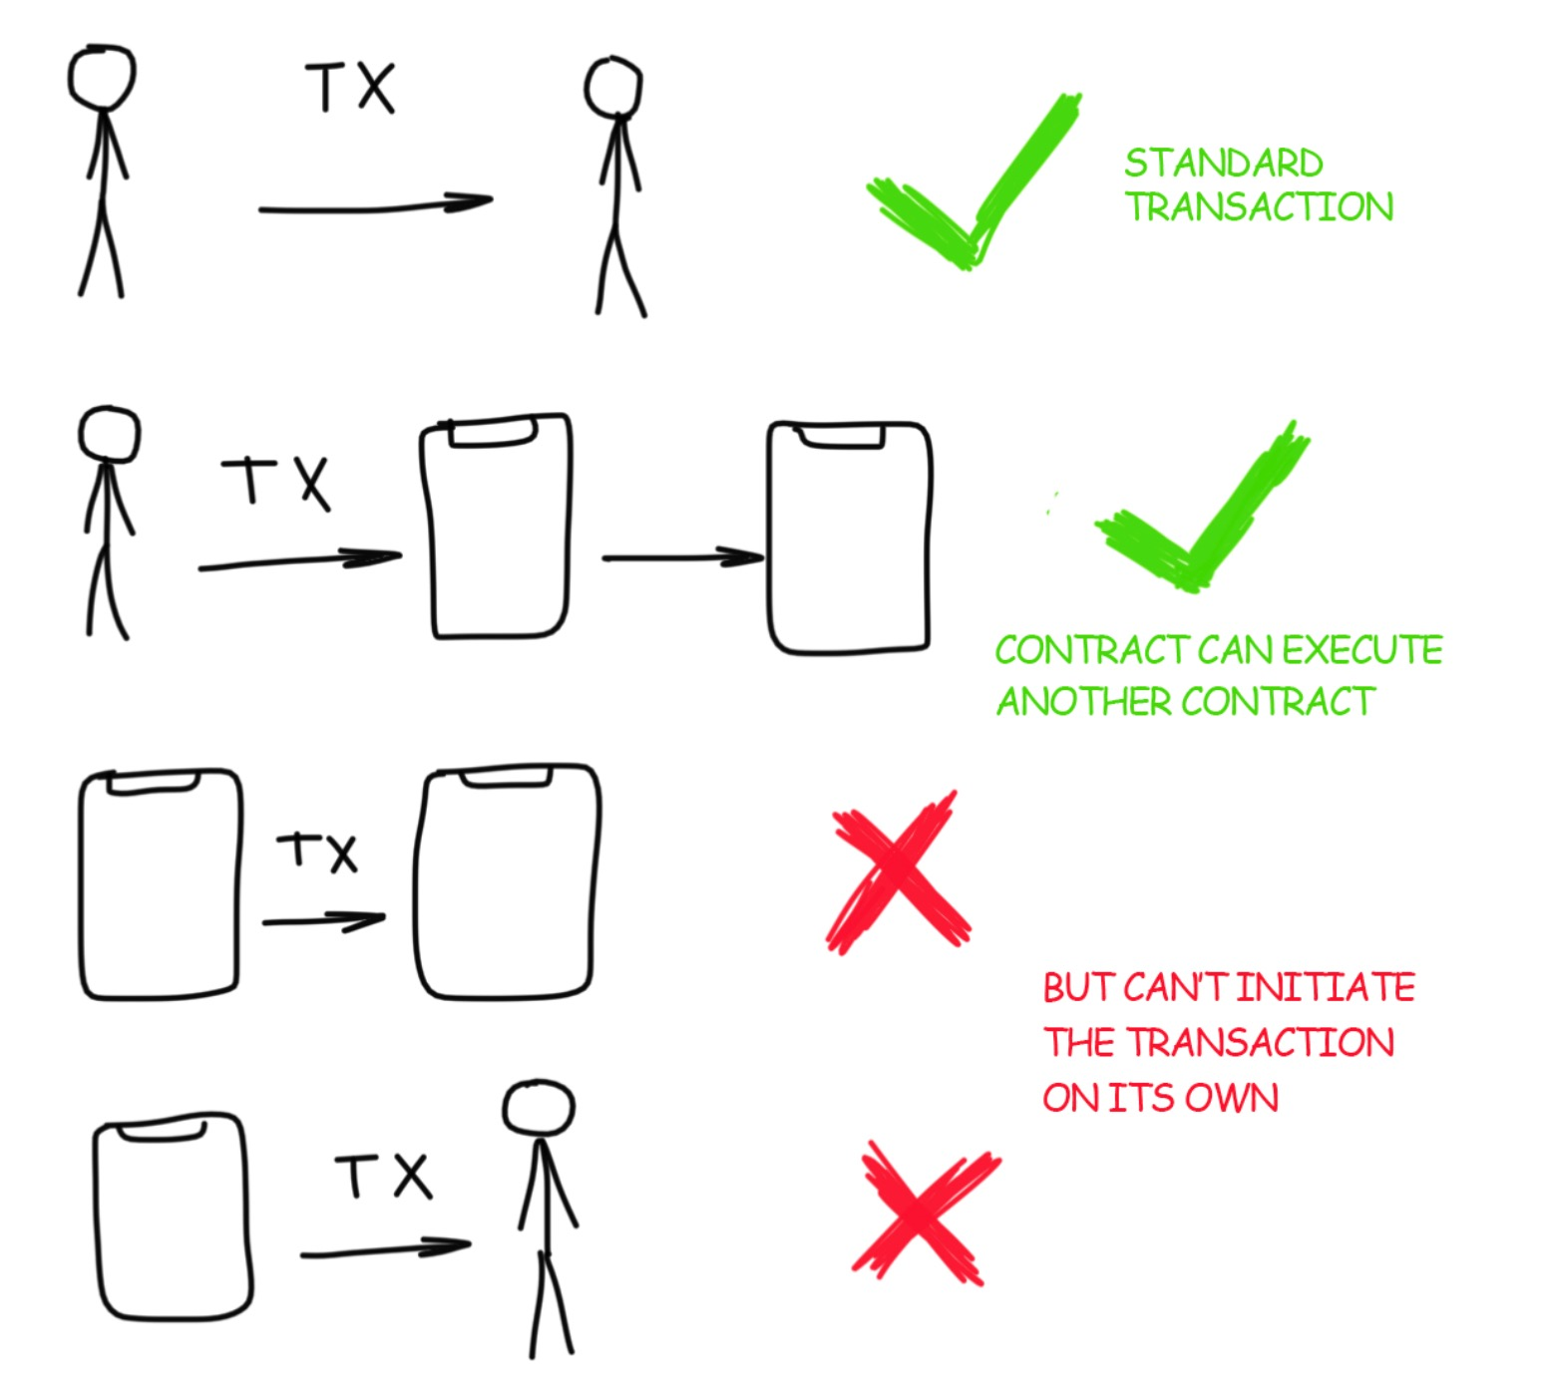

Slide 43
A Simple Contract: A Test Ether Faucet
Ethereum has many different high-level languages, all of which can be used to write a contract and produce EVM bytecode.
One high-level language is by far the dominant choice for smart contract programming: Solidity.

Slide 44
A Simple Contract: A Test Ether Faucet
For our first example, we will write a contract that controls a faucet.
A faucet is a relatively simple thing: it gives out ether to any address that asks, and can be refilled periodically.

Slide 45
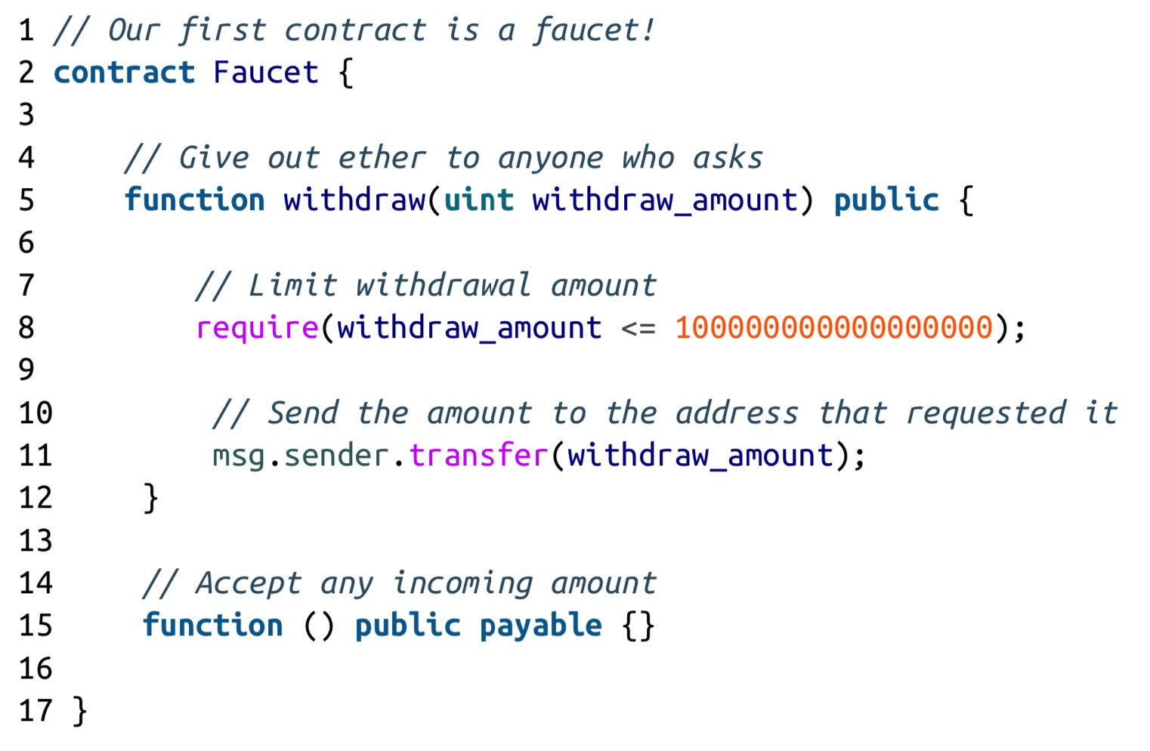
A Simple Contract: A Test Ether Faucet

Slide 46
pragma solidity >=0.4.21 <=0.7.0;
// Version of Solidity compiler this program was written for
// Our first contract is a faucet!
contract Faucet {
// Give out ether to anyone who asks
function withdraw(uint withdraw_amount) public {
// Limit withdrawal amount
require(withdraw_amount <= 100000000000000000);
// Send the amount to the address that requested it
msg.sender.transfer(withdraw_amount);
}
// Accept any incoming amount
function () external payable {}
}

Slide 47
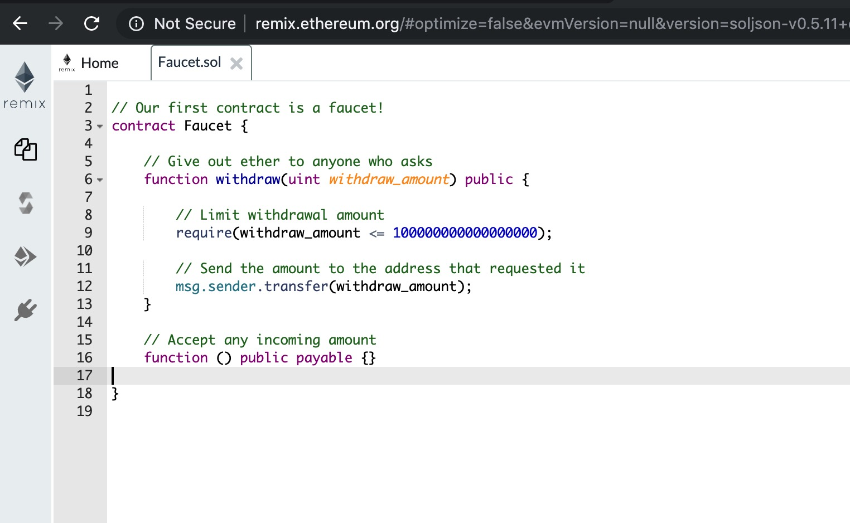
A Simple Contract: A Test Ether Faucet

Slide 48
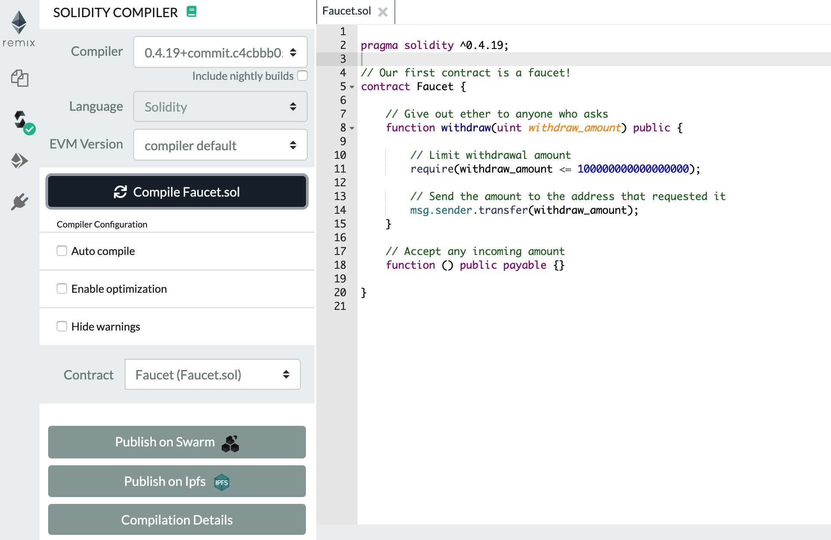
A Simple Contract: A Test Ether Faucet

Slide 49
Creating the Contract on the Blockchain
So, we have a contract. We’ve compiled it into bytecode. Now, we need to “register” the contract on the Ethereum blockchain.
Registering a contract on the blockchain involves creating a special transaction whose destination is the address 0x0000000000000000000000000000000000000000, also known as the zero address.

Slide 50
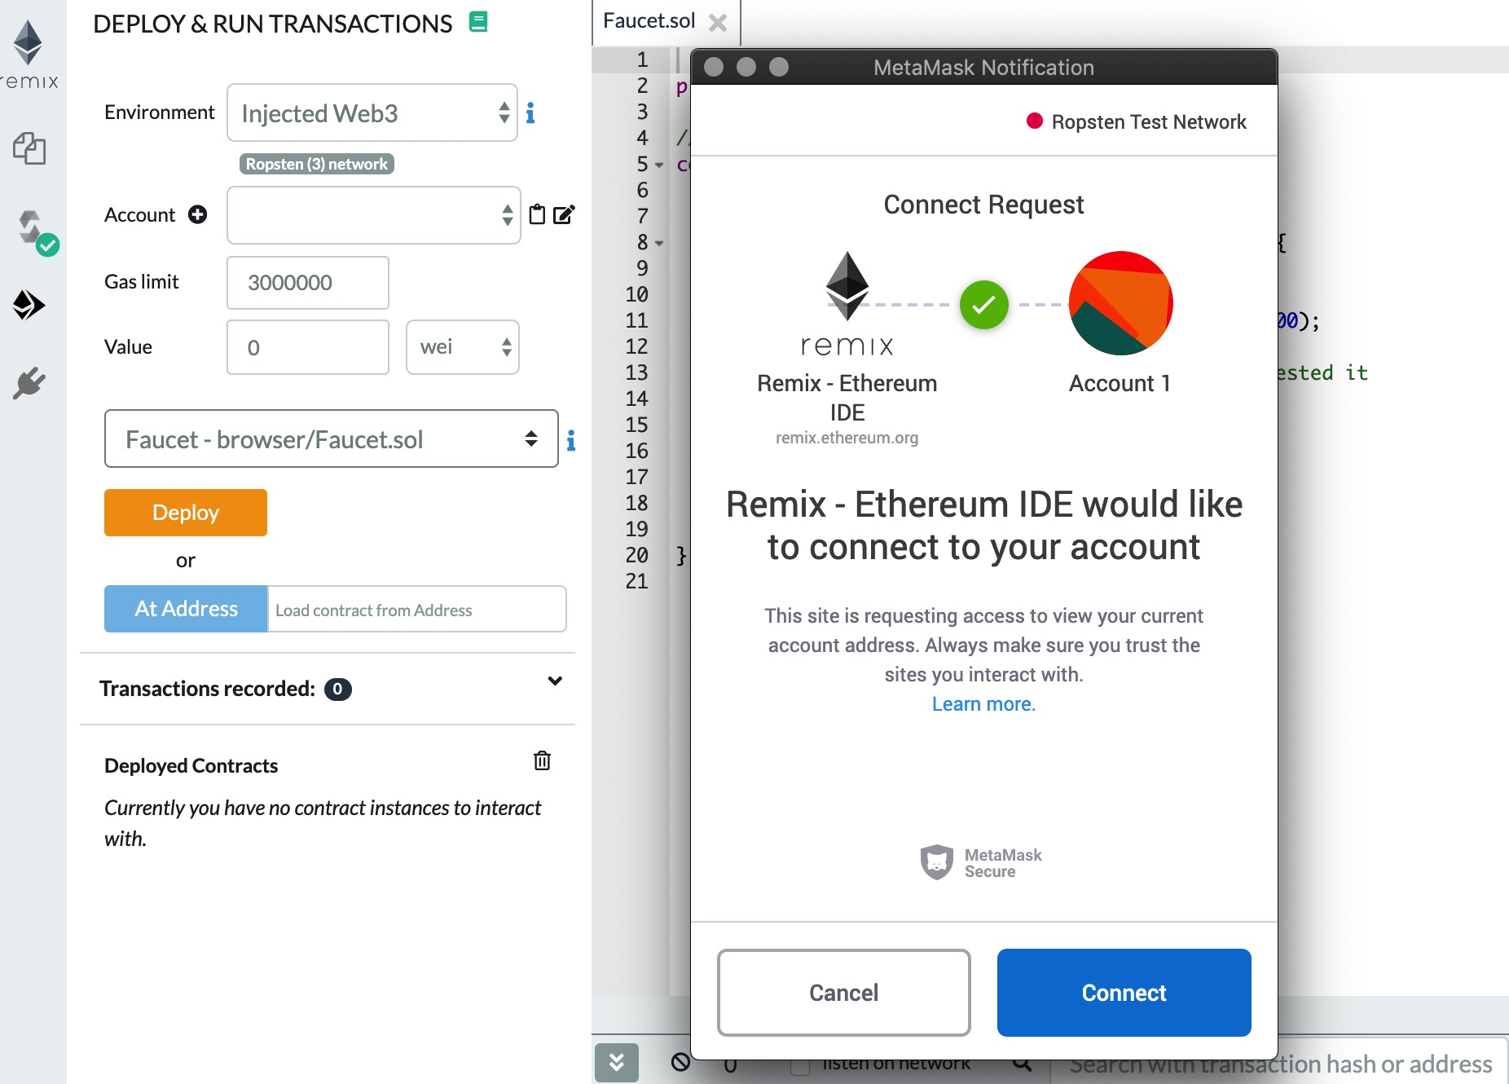
Creating the Contract on the Blockchain

Slide 51
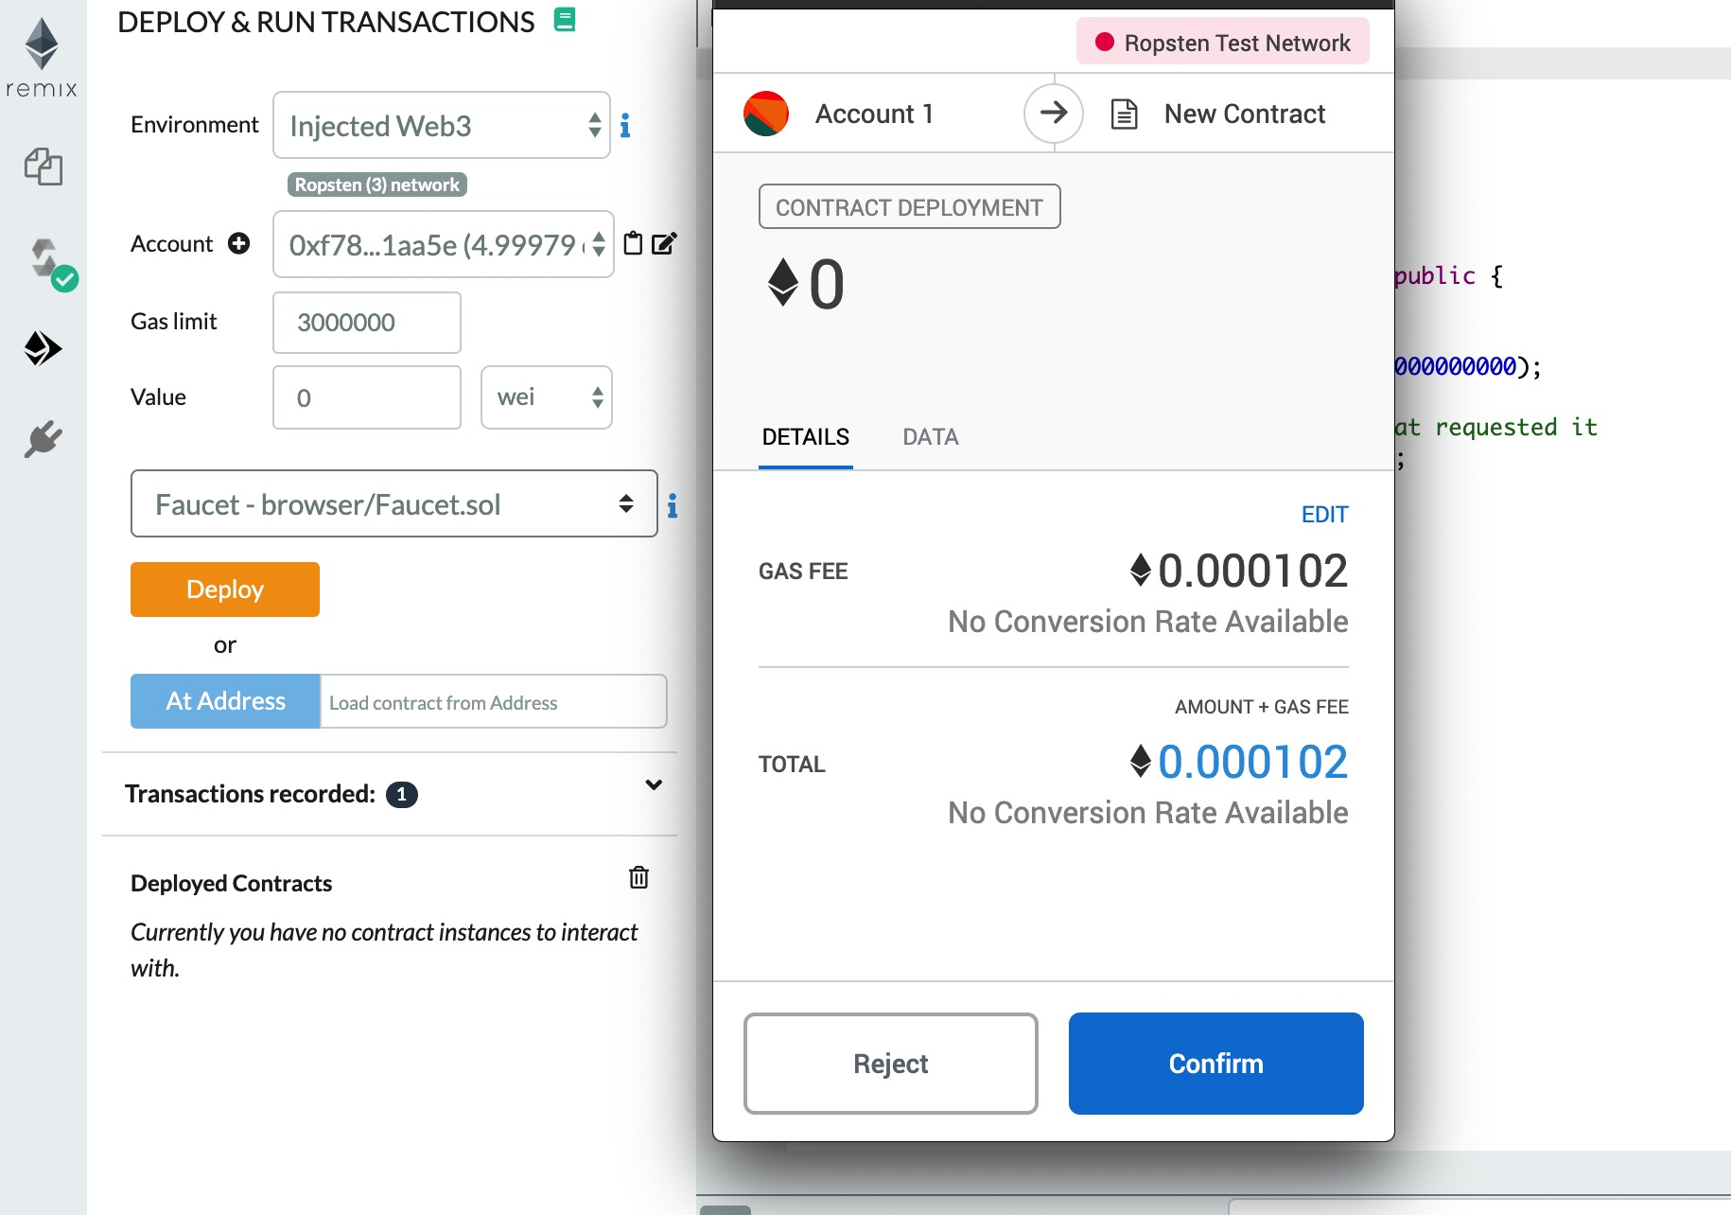
Creating the Contract on the Blockchain

Slide 52
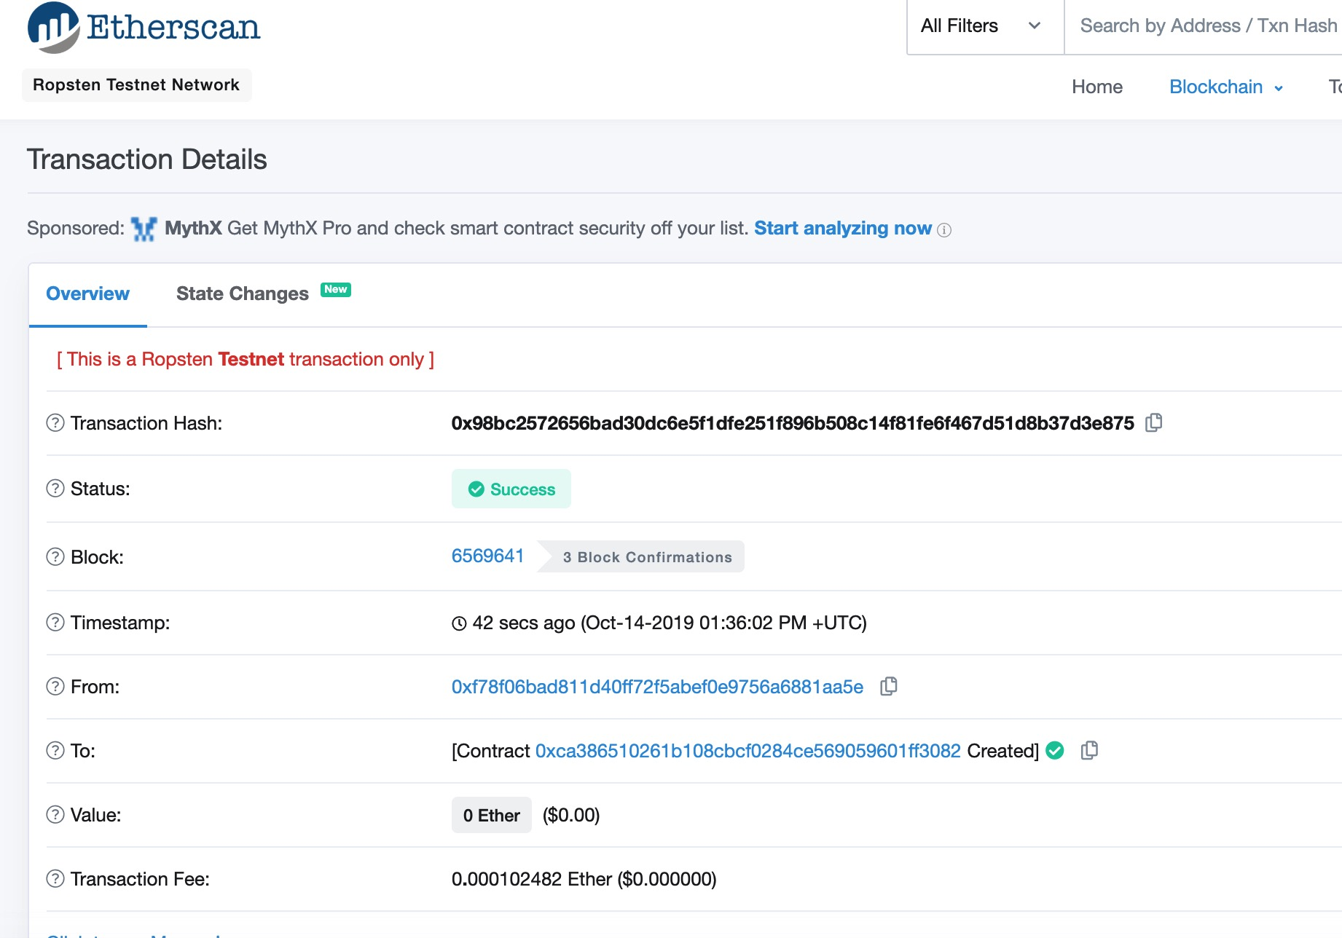
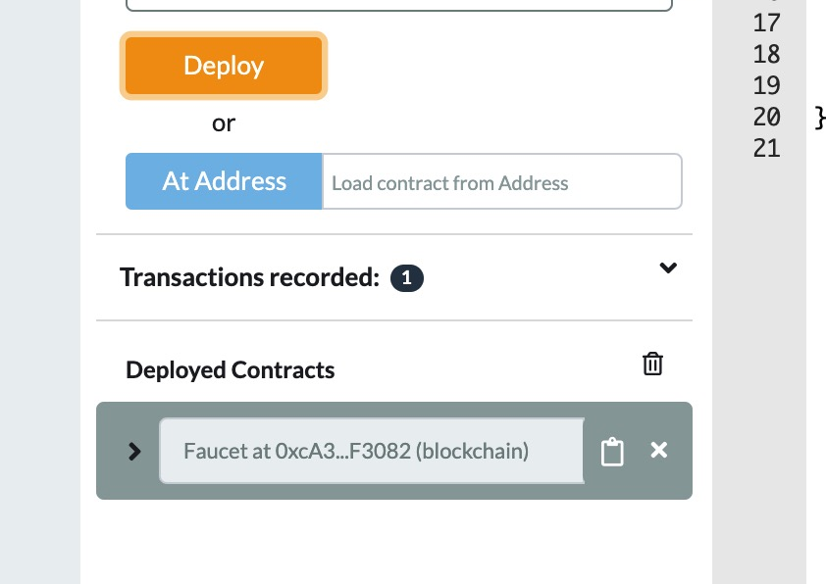
Creating the Contract on the Blockchain

Slide 53
Interacting with the Contract
Ethereum contracts are programs that control money, which run inside a virtual machine called the EVM.
They are created by a special transaction that submits their bytecode to be recorded on the blockchain.
Once they are created on the blockchain, they have an Ethereum address, just like wallets.

Slide 54
Interacting with the Contract
Anytime someone sends a transaction to a contract address it causes the contract to run in the EVM, with the transaction as its input.
Transactions sent to contract addresses may have ether or data or both. If they contain ether, it is “deposited” to the contract balance. If they contain data, the data can specify a named function in the contract and call it, passing arguments to the function.

Slide 55
Funding the Contract
For now, the contract only has one transaction in its history: the contract creation transaction.
As you can see, the contract also has no ether (zero balance).
That’s because we didn’t send any ether to the contract in the creation transaction, even though we could have.
Our faucet needs funds! Our first project will be to use MetaMask to send ether to the contract.

Slide 56
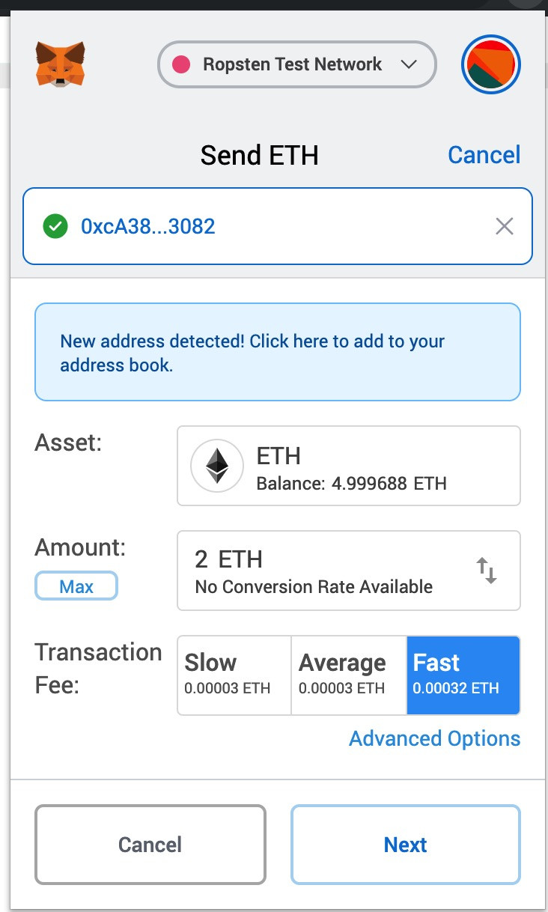
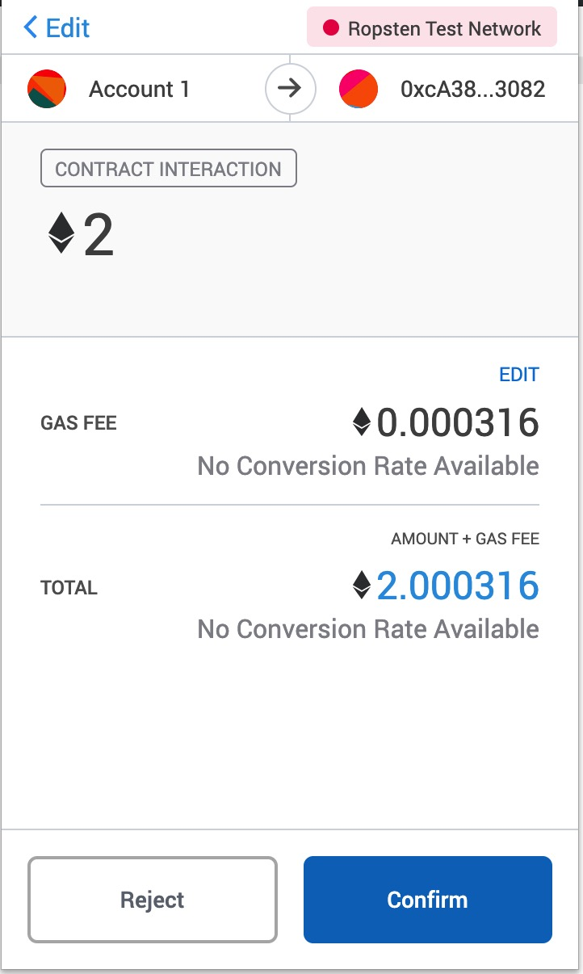
Funding the Contract

Slide 57
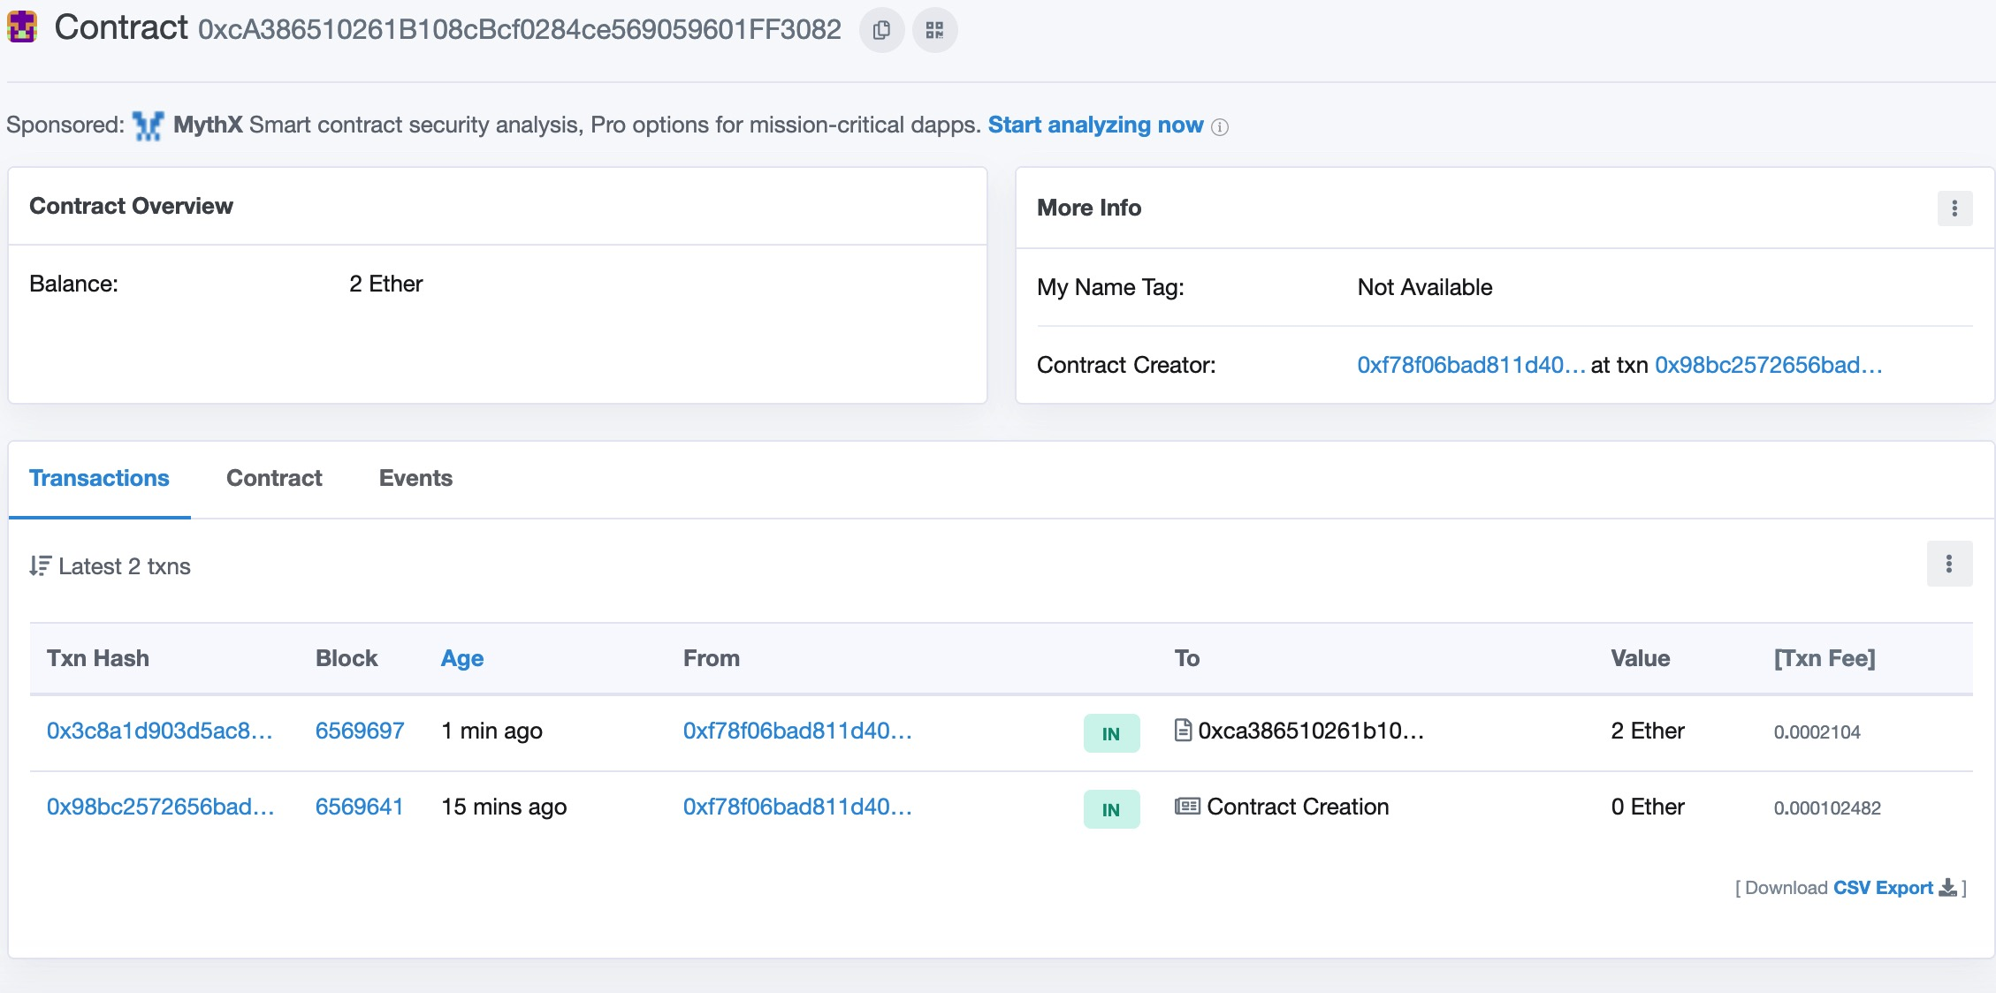
Funding the Contract

Slide 58
Funding the Contract
When you sent a transaction to the contract address, with no data specifying which function to call, it called this default function.
Because we declared it as payable, it accepted and deposited 2 ethers into the contract’s account balance.
^{function() public payable {}}

Slide 59
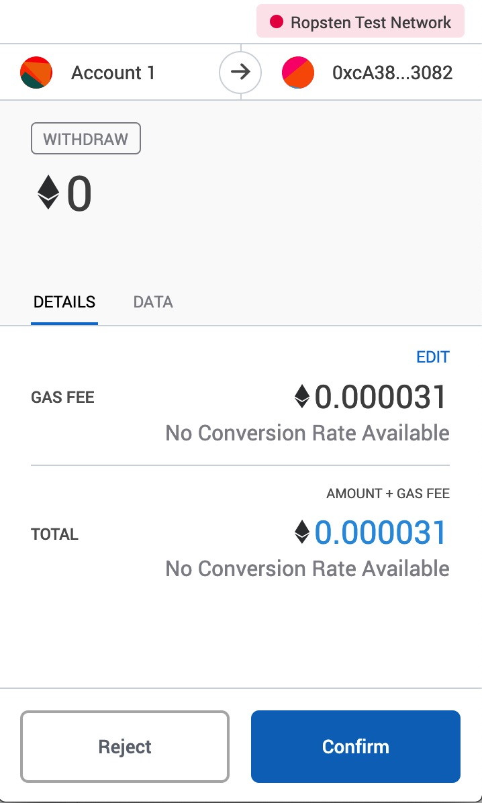
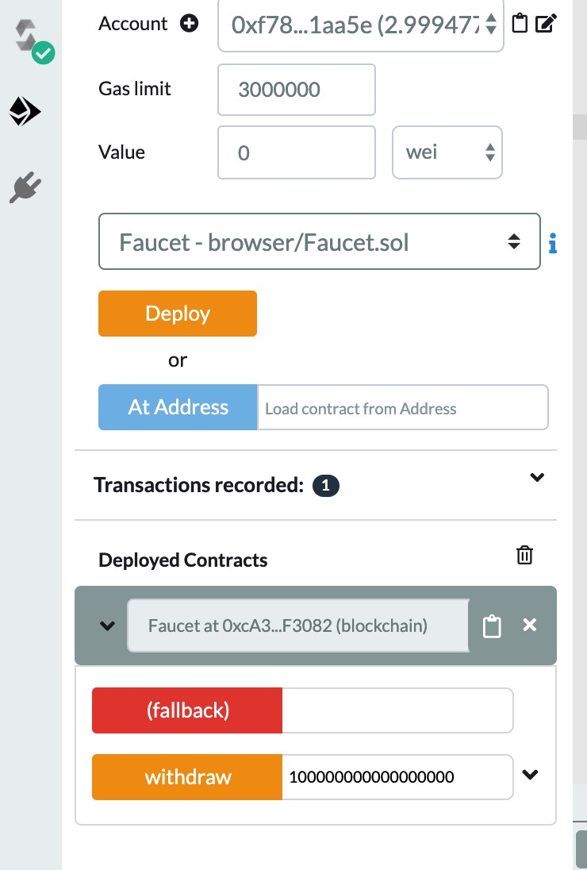
Withdrawing from Our Contract

Slide 60
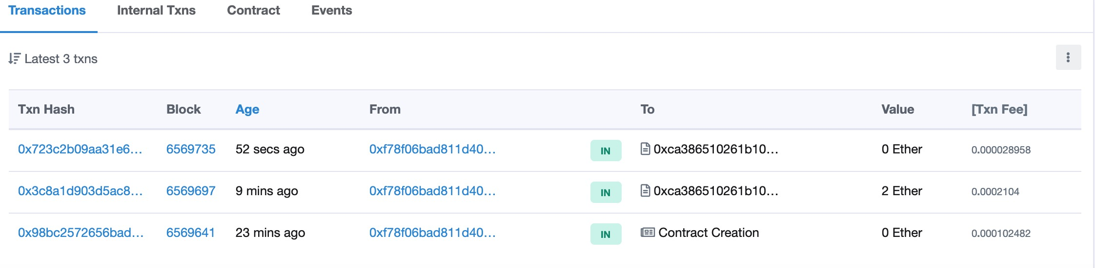
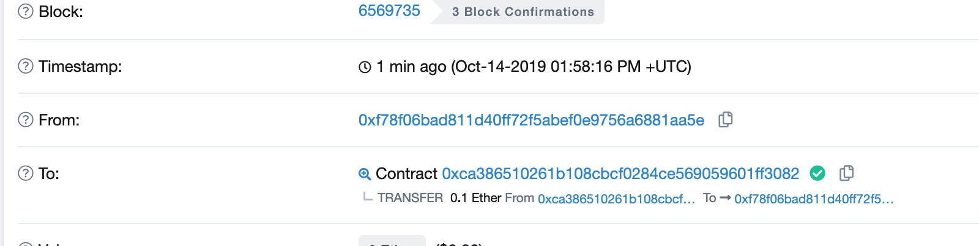
Withdrawing from Our Contract

Slide 61
msg.sender.transfer(withdraw_amount);
To recap: you sent a transaction from your MetaMask wallet that contained data instructions to call the withdraw function with a withdraw_amount argument of 0.1 ether.
That transaction caused the contract to run inside the EVM.

Slide 62
msg.sender.transfer(withdraw_amount);
As the EVM ran the Faucet contract’s withdraw function,
first it called the require function and vali‐ dated that the requested amount was less than or equal to the maximum allowed withdrawal of 0.1 ether.
Then it called the transfer function to send you the ether. Running the transfer function generated an internal transaction that deposited 0.1 ether into your wallet address, from the contract’s balance. That’s the one shown on the Internal Transactions tab in Etherscan.

Slide 63
Improved Faucet Contract
pragma solidity ^0.4.19;
contract Faucet {
address owner;
constructor(){
owner = msg.sender
}
function withdraw(uint withdraw_amount) public {
// Limit withdrawal amount
require(withdraw_amount <= 0.1 ether);
require(msg.sender == owner);
// Send the amount to the address that requested it
owner.transfer(withdraw_amount);
}
// Accept any incoming amount
function () public payable {}
}

Slide 64
How to update our contract deployed on the chain?

Slide 65
Do not distribute ...
These slides are not always prepared by me.
Most of the content comes from the reference book
Mastering Ethereum: Building Smart Contracts and Dapps
Book by Andreas Antonopoulos and Gavin Wood Ph.D.

Slide 66
Homework
Setup Metamask and send me some ethers at the address below
0xa1E14e02109b82640732a0bbe61b912dc7d06BfF

